Slide 1
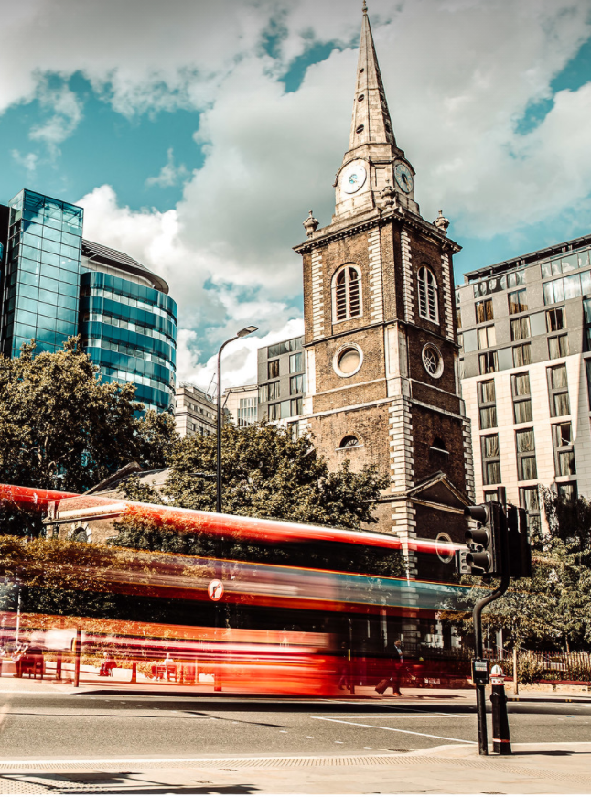
Aldgate Connect bid:
Baseline Study & Economic Analysis
December 2020
Source: Aldgate Connect BID

Slide 2
Contents
 | Chapter | Page Number
1. | Executive Summary | 3
2. | Introduction | 4
3. | Socio-economic Baseline Assessment | 8
4. | Development Pipeline | 22
5. | Key Challenges and Opportunities | 26
6. | Conclusions | 35
7. | Appendices | 37

Slide 3
Executive summary Aldgate connect bid
Aldgate supports a residential population of approximately 8,050 people.
Aldgate currently supports approximately 47,100 jobs in one of the densest parts of London.
Since 2015 total jobs across Aldgate has risen by 4,410. This equates to a 10% increase.
27% of Aldgate’s workforce are employed in the financial and insurance sector, and a further 23% in the professional sector.
The high value nature of the employment supported within Aldgate is reflected in a GVA generation of approximately £6 billion annually.
The Aldgate economy generates tax revenues in the region of £2.2 billion annually.
In net terms, a total of 121,000 sqm of additional non-residential space has been constructed over the period 2005-2019. This is anticipated to have generated between 4,200 and 5,000 additional jobs.
The Aldgate Economy is set to benefit from a number of technology led interventions in the coming years which could lead to higher value employment opportunities and huge productivity benefits.
Source: Aldgate Connect BID

Slide 4
2. introduction

Slide 5
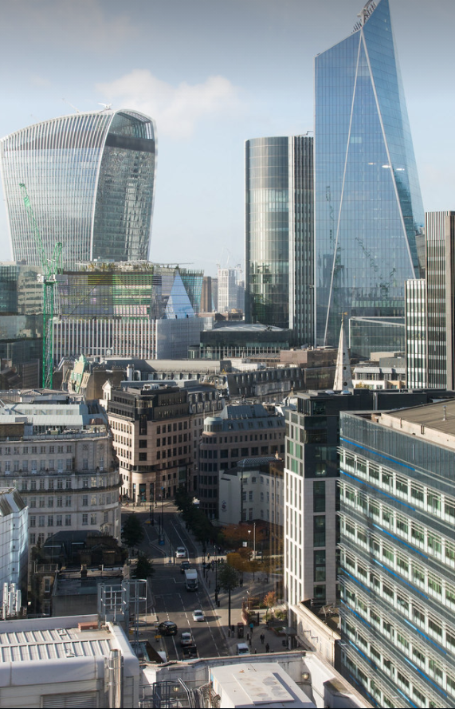
introduction economic context
The Aldgate Connect BID was formed in 2020 to support the development of the Aldgate area, and to help drive inclusive economic growth and regeneration for Aldgate’s residents and business base. WSP has been commissioned by Primera Corporation to undertake a detailed socio-economic baseline study into the BID, elucidating the key economic characteristics and profile of the area, assess the potential impact of the area’s development pipeline, as well as identify future opportunities and challenges which will impact the BID going forward.
The Aldgate Connect BID started life as the Aldgate Partnership in 2014 and was formed to support the development of a new and vibrant district in Aldgate, enhancing both the business base but also the physical environment, thus creating a stronger and more appealing destination. The aim of the BID is to continue to reposition Aldgate as a lively and engaging location, developing its own distinct character that can be enjoyed by both its residents, workers and visitors.
Unlike a number of other City BIDs, the Aldgate Connect BID is unique in that its boundary encompasses areas of both the City of London (the City) and the London Borough of Tower Hamlets. As a result, the BID has a diverse and varied offering. To the west is the City’s financial district, made up of large office blocks and home to businesses which predominately specialise in high-value banking and insurance services. In the south, there is significant untapped potential from the major tourist hub that is the Tower of London, while to the east lie the growing residential districts of Tower Hamlets and the associated community facilities. The area is also home to cultural institutions such as the Whitechapel Gallery, Toynbee Hall and Petticoat Lane Market.
Despite having all the ingredients to thrive, Aldgate has tended to underperform economically and continues to experience social challenges, with pockets of high deprivation found in the north east section of the BID. More generally, the area feels disjointed, and tends to lack a distinct identity. The onset of the Covid-19 pandemic will have exacerbated a number of these issues.
The role the Aldgate Connect BID has in promoting this unique part of London, in collaboration with the City of London Corporation and Tower Hamlets, as well as key stakeholders such as TfL and the GLA, will be of great importance as the area navigates the coming months and years.
Source: Aldgate Connect BID

Slide 6
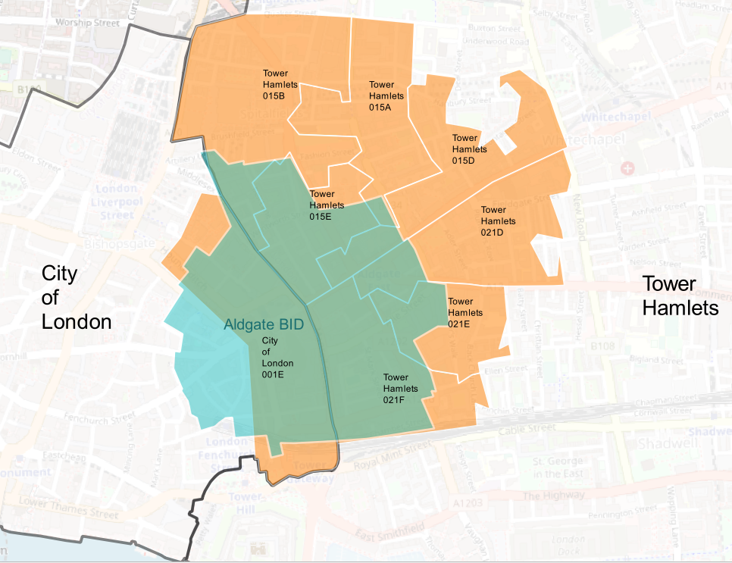
introduction Aldgate bid geography
The Aldgate Connect BID straddles the City of London (CoL) local authority and the London Borough of Tower Hamlets. It encompasses areas of the City’s Financial District to the west, Tower of London to the south, Whitechapel to the east and residential districts to the north. The geographical size of the BID is approximately 50.6 hectares, 22.5 hectares within the City and 28.1 within Tower Hamlets.
The BID’s location in the heart of the City means it is easily accessible by public transport, with two London Underground stations (Aldgate and Aldgate East), one rail station (Fenchurch Street) and one Docklands Light Railway (DLR) station (Tower Gateway) located within or in close proximity to the Aldgate Connect boundary.
In terms of smaller geographical areas, the Aldgate Connect BID has a presence across nine Lower Layer Super Output Areas (LSOAs) to varying degrees:
City of London 001E;
City of London 001F;
Tower Hamlets 015E;
Tower Hamlets 015A;
Tower Hamlets 015B;
Tower Hamlets 015D;
Tower Hamlets 021D;
Tower Hamlets 021E; and
Tower Hamlets 021F
LSOAs are an ONS geography and one of the smallest areas for which economic and social data can be analysed. The majority of the Aldgate Connect BID is located across the four LSOAs of City of London 001F and 001E, and Tower Hamlets 015E and 021F, with smaller proportions spread across the remaining LSOAs.
The BID boundary, in relation to LSOAs and borough boundaries, is illustrated in Figure 1.
In preparing this Study, WSP has also reviewed a report prepared by the economic consultancy firm Volterra in January 2017, which assessed the socio-economic profile of the then Aldgate Partnership. While the objectives of the Volterra report are similar to this one, the results are notably different, and reflect the different geographic boundaries implemented for the Aldgate Connect BID, and the former Aldgate Partnership. There are also a number of methodological differences behind how the socio-economic statistics have been derived between the reports. A comparison between the two pieces of work can be found in the Appendix 1.
Figure 1 – Aldgate BID area boundaries (blue) relative to LSOA boundaries (orange)
Background Map: OS

Slide 7
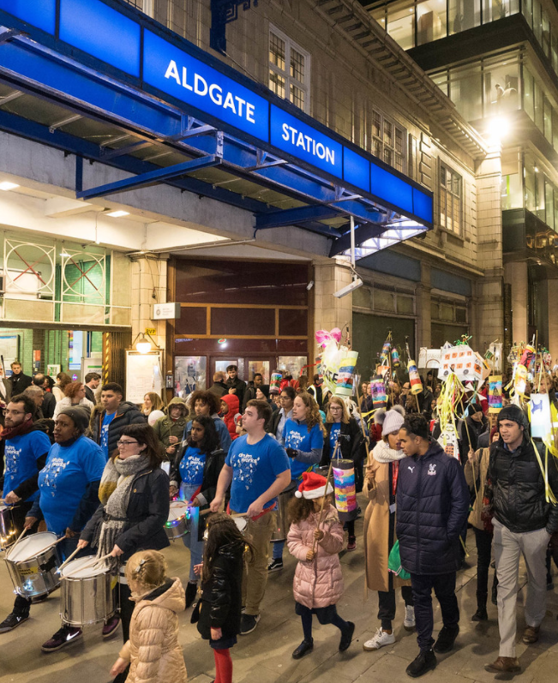
introduction methodology
In order to undertake the socio-economic baseline assessment, WSP has drawn on a range of publicly available data sources. These have included:
National Online Manpower Information System (NOMIS);
Annual Population Survey/Labour Force Survey (ONS);
Business Register and Employment Survey/Annual Business Inquiry (ONS);
Population Estimates/Projections (ONS);
Transport for London (TfL);
Planning portals of City of London and Tower Hamlets; and
London Datastore (GLA)
These data sources have been supplemented with a review and assessment of any data/analytical research or emerging policy frameworks available directly from Primera, the BID partnership or from the City of London Corporation and Tower Hamlets.
Pertinently for the baseline assessment, the geography of the BID area does not exactly match any standard geographic areas for which data is recorded. For example, the BID has a presence across nine LSOAs to varying degrees (see Figure 1 for an example of this). As a result, estimates of economic statistics are approximated and scaled based on the proportion of the Aldgate Connect BID within geographic areas for which data is available, calculated using GIS. The respective scaling of socio-economic statistics for the BID area is outlined in the Appendix 2.
WSP has also held discussions with members of the Aldgate Connect Board – including the Chair Ian Mulcahey, representatives from the City of London research team, and Primera corporation. These discussions have been used to gain an insight into the existing strengths and weaknesses of the BID, and where the future opportunities and challenges lie. These discussions have supported the economic analysis undertaken within the report.
From hereon in, the Aldgate Connect BID shall be referred to as Aldgate within this report.
Source: Aldgate Connect BID

Slide 8
3. Socio-economic baseline assessment

Slide 9
population Aldgate bid population
Figure 2 - Population in Aldgate by local authority and recent growth in population
The resident population of Aldgate has been estimated based on 2019 LSOA population data obtained from the ONS, scaled appropriately using the proportions outlined in Appendix 1.
Based on this approach, it is estimated that Aldgate is home to approximately 8,050 people (1,480 residing within the City of London portion of the BID and 6,570 within Tower Hamlets). A disproportionately large share of the BID population are within the Tower Hamlets portion of the area. This is illustrated in Figure 2.
The following illustrates the age breakdown of the population in 2019, with the highest proportion between the ages of 16-64 (82.4%). :
Aged 0 -15: 1,020 people
Aged 16 – 64: 6,630 people
Aged 65+: 400 people
There has been significant growth in Aldgate’s resident population in recent years. In comparison to 2015, the total population has increased from 6,300 to 8,050- a growth rate of 28%, with people aged between 0-15, 16-64 and 65+ increasing by 40%, 26% and 21% respectively. Figure 3 illustrates the population of Aldgate based on this approach.
A resident population of 8,050 equates to a population density (number of people per square kilometre) of 15,920. This is significantly greater than figures estimated for the City of London, and London as a whole, but in line with the figure for Tower Hamlets (Figure 3).
In general, dense residential locations such as Tower Hamlets have lower levels of employment density since demand for residential space crowds out commercial space. The opposite is true for areas of high employment density such as the City of London, and inner City BIDs such as Cheapside and the Eastern City Partnership.
However, as will be illustrated later in this report, Aldgate also has a high concentration of employment. Aldgate is therefore a bit of an outlier in this respect, in that it has both high population and employment densities. This is owed to the fact that the BID boundary straddles both the employment-dense area of the City of London, and the more residential orientated Tower Hamlets.
8,050
7,010
7,550
6,300
6,670
Population of 8,050 in 2019
Figure 3 - Population Density in 2019 (selected geographies)
Source: WSP Calculation based on ONS Population Estimates and land areas by the London Datastore

Slide 10
population Ethnicity
Table 1 – Ethnic mix of the Residential Population (selected geographies)
 | White | Mixed | Asian | Black African/ Caribbean/ Other Black | Arab | Other ethnic group
TH/Aldgate (2011) | 45% | 4% | 41% | 7% | 1% | 1%
TH/Aldgate (2020) | 46% | 5% | 40% | 7% | 1% | 2%
London (2011) | 60% | 5% | 19% | 13% | 1% | 2%
London (2020) | 56% | 6% | 21% | 13% | 2% | 2%
The ONS and GLA do not publish non-Census ethnicity data at the LSOA level, and therefore it is not possible to scale data appropriately for Aldgate. In the absence of this, WSP has considered the population ethnicity breakdown of Tower Hamlets, and have assumed this is a fair reflection of Aldgate, given the majority of Aldgate’s resident population falls within Tower Hamlets.
The latest projections from the GLA estimates that in 2020, 54% of the residential population in Aldgate are from a BAME background, down slightly from 55% in 2011. Greater London’s population is less diverse, with 44% of the population coming from BAME backgrounds in 2020.
Table 1 sets out the ethnic mix of the residential populations across Tower Hamlets (and for the purpose of this exercise Aldgate), compared to Greater London as a whole. Other than White, Asian is the most common ethnicity group, at 40% of the population in 2020, and has remained stable since 2011. A similar picture is seen when considering Greater London as a whole, with 21% of the population from Asian descent, up marginally from 19% in 2011.
The ethnicity of Tower Hamlets’ residential population has remained relatively stable over the last decade. Figure 4 illustrates the more detailed breakdown of BAME ethnic groups within Aldgate, and how the proportions have evolved since 2011. The main difference between the 2011 and 2020, is the decreasing number of people with Bangladeshi ethnicity within Aldgate, falling from 58% of the BAME population to 53% in 2020, a 5 percentage point decrease. That said, Bangladeshi still remains the dominant ethnicity amongst Aldgate’s BAME population.
Considering the detailed breakdown of BAME groups, the three main ethnicities within Tower Hamlets in 2020 are:
Bangladeshi (53%)
Black African/Caribbean/ Other (13%)
Mixed (9% of all BAME)
These groups account for 75.0% of all BAME residents in Tower Hamlets (and Aldgate based on our assumptions).
Based on our discussions with members of the Aldgate Board, many felt that there was a lack of social integration between residents and workers in the area. This issue will be explored in more detail in the Opportunities and Challenge section of this report.
Source: Greater London Authority
Figure 4 – Breakdown of BAME Ethnic Groups in the Aldgate BID
2011
2020
Source: Greater London Authority

Slide 11
employment total jobs
Figure 5 - Employment in Aldgate by Local Authority
The number of jobs supported across Aldgate has been estimated using the ONS’ Business Register and Employment Survey (BRES) for 2018, which is disaggregated at the LSOA level. As outlined in the methodology section, the LSOA data has been scaled appropriately to fit the geography of the BID.
In 2018, Aldgate supported approximately 47,100 jobs across a range of sectors. When apportioning the number of jobs to the constituent Local Authorities, this equates to 29,880 jobs in the City of London (63% of total) and 17,220 in Tower Hamlets (37% of total). This is illustrated in Figure 5, confirming that the areas of Aldgate located within the City have a greater share of local jobs than those in Tower Hamlets.
The total number of jobs supported across Aldgate has risen from 42,690 jobs in 2015, an increase of 4,410 (10.3% or a CAGR of 3.3%). This is a greater annual increase than that seen across Tower Hamlets (2.5%) and London as a whole (1.6%).
As will be analysed in more detail shortly, Aldgate specialises in a number of highly-skilled industries which generate significant value to the local economy. The top three industries in terms of employment are:
Financial & Insurance – 12,560 jobs (26.7% of total)
Professional, Scientific & Technical – 10,720 jobs (22.8% of total)
Information and Communication – 5,360 jobs (11.4% of total)
At the same time, Aldgate also supports a high proportion of jobs in the accommodation and food services sector (2,830 in 2018). This was the fifth biggest sector in employment terms and supports the hypothesis that Aldgate is a service-based economy of two halves, comprising a set of globally competitive advanced producer services (e.g. financial/insurance, tech) together with more locally focused sectors (e.g. food and drink, accommodation) providing lower-value personal and household services. Both have grown in recent years and they are, to some extent, complementary.
Considering recent growth, it is both the low and high value service-based sectors which have seen the greatest increase in employment within Aldgate.
The Industries which saw the greatest increases in employment (in absolute terms) were the following:
Professional, Scientific & Technical (+3,100)
Information and Communication (+1,320)
Accommodation & food services (+570)
Growth in these three sectors helped to offset some of the decline in the Financial & Insurance sector, which has seen a reduction in 3,060 jobs between 2015-2018. This equates to a 19.6% fall in jobs as illustrated in Figure 6.
Part of this decline, it is contended by many, is a result of Brexit induced uncertainty, as will be explored in more detail in the Opportunities and Challenges section of this report.
47,100 Jobs in 2018
10% increase in jobs 2015-2018
Figure 6 - Top Employment Sectors for Aldgate and recent growth / contraction
Source: WSP Calculation based on Business Register and Employment Survey data

Slide 12
Sector composition top employment sectors
Figure 7 - Employment Sectors for Aldgate in 2018
The top 5 employment sectors within Aldgate are illustrated in Figure 7, and in more detail on the previous slide.
The dominant sector of employment across Aldgate is the Financial and Insurance sector, employing 26.7% of the workforce (or 12,560 people). This is in spite of the recent falls in employment seen since 2015.
While the Financial and Insurance sector is the dominant employer across Aldgate, the sector encompasses a vast range of services including activities such as fund management, banking and security, and commodity contracts brokerage.
In order to develop a greater understanding of the services that drive the Aldgate BID, analysis has been undertaken using the more detailed 2 Digit Standard Industrial Classification (SIC) Codes. Based on this, the top 3 sub-sectors in terms of employment within Aldgate are:
Activities Auxiliary to Financial Services and Insurance Services (7,070 jobs and 15% of total workforce) - This division includes the provision of services involved in or closely related to financial service activities, but not themselves providing financial services, such as:
Stock Exchange
Foreign Currency Exchange
Financial services activities, except insurance (4,910 jobs and 10% of total workforce) - this includes activities undertaken by:
Banks
Building societies
Central banks
Activities of head offices and management consultancy services (3,130 jobs and 7% of total workforce) – this includes:
Activities of Head Offices
Business and other management consultancy activities
Financial Management
A notable observation, and perhaps one that is not surprising given the wider trends in the financial and insurance sector highlighted previously, is the fall in employment in the sub-sector auxiliary financial services, which has seen over a quarter of jobs lost since 2015. This, as will be discussed in the Opportunities and Challenges chapter, is contended by many as at least partially a result of Brexit-induced uncertainty, leading some firms to reallocate assets to Europe. However there is also likely to be an element of how new types of employment are categorised, with the rise of fintech and legaltech firms blurring the lines between what activities are classified under financial related employment and what is classified under tech employment. More details of how technology is reshaping the nature of employment is explored later in this report.
The more detailed sector analysis also illustrates that Aldgate has a high concentration of employment in the legal and accounting sector, architectural and engineering activities, computer programming and food and beverage services. This analysis is set out in Figure 8.
These sectors, barring the food and beverages sector, are all highly skilled, high value sectors, which generate considerable economic value for London and the wider UK economy, as will be demonstrated later in this report.
While not generating the same amount of value in terms of GVA, the importance of the food and beverages sector to Aldgate’s eco-system should not be downplayed. The sector acts as a key facilitator for employees of other services, and provides a vibrancy and energy to the area which would be sorely missed.
47,100 Jobs in 2018
Figure 8 - Detailed employment sectors within Aldgate in 2018
Source: WSP Calculations based on Business Register and Employment Survey data

Slide 13
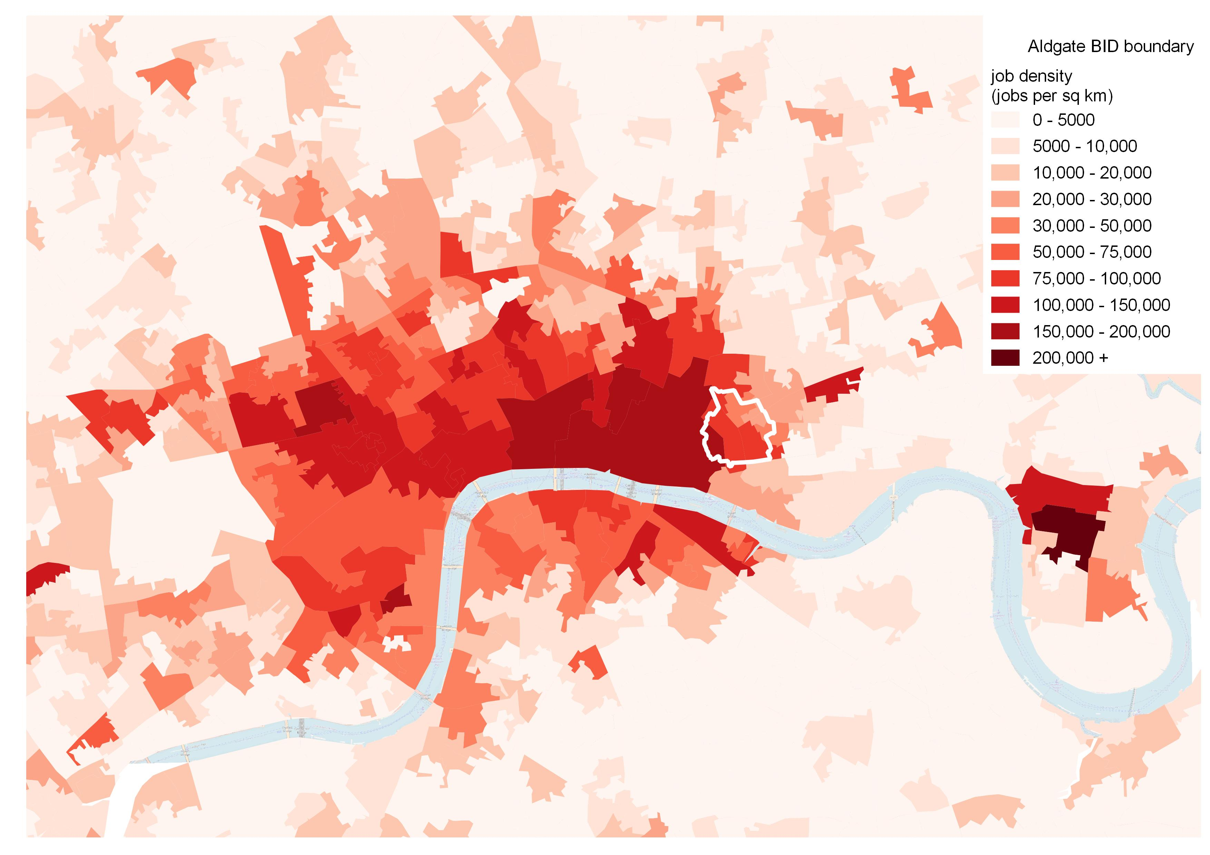
employment job density
Figure 9 - Job Density in Inner London (jobs per sq. km, 2018)
The previous analysis suggests that approximately 47,100 people are employed across Aldgate’s 0.506km² (50.6 hectare) area – equivalent to an employment density (number of employees per km²) of 93,130. This is significantly greater than corresponding employment densities of Tower Hamlets (15,030) and Greater London as a whole (3,280), but lower than that recorded for the City (174,220). It should be noted that the Greater London data is skewed by the inclusion of all non-employment land areas (e.g. housing and parks) with a greater prevalence of these assets provided outside of the City of London.
Mapping the employment density by LSOA, as shown in Figure 9, illustrates the divergence in employment densities across the BID area.
Areas to the west, and in particular the south west corner of the BID, which are located in the City of London’s Financial District, have the highest employment density, confirming these areas as the BID’s main employment hub.
Concurrently, areas to the north and east have a much lower employment density, reflective of the more residential oriented areas of Aldgate located within the local authority of Tower Hamlets.
Aldgate's overall employment density of 93,130, compared to the City of London’s 174,220 confirms that Aldgate has a variety of land allocations including employment, residential and recreational uses, underlining the diversification of uses in this corner of the square mile.
Source: Business Register Employment Survey data

Slide 14
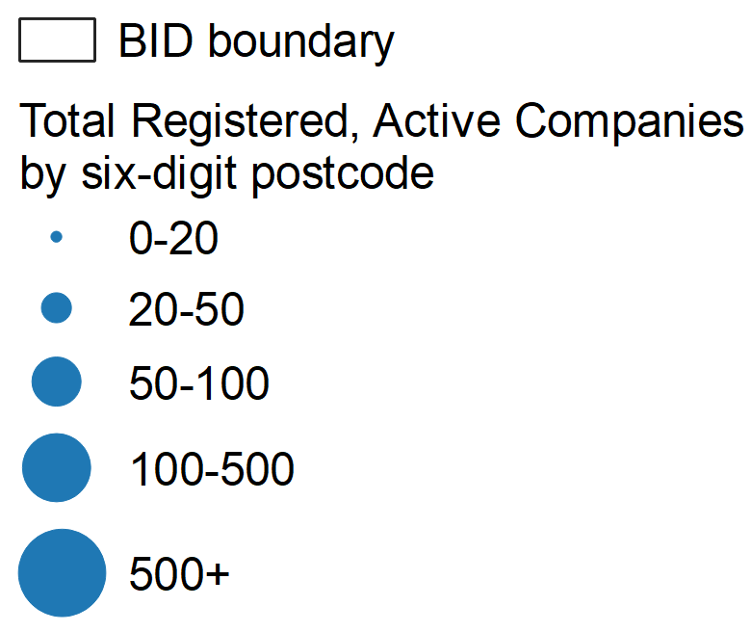
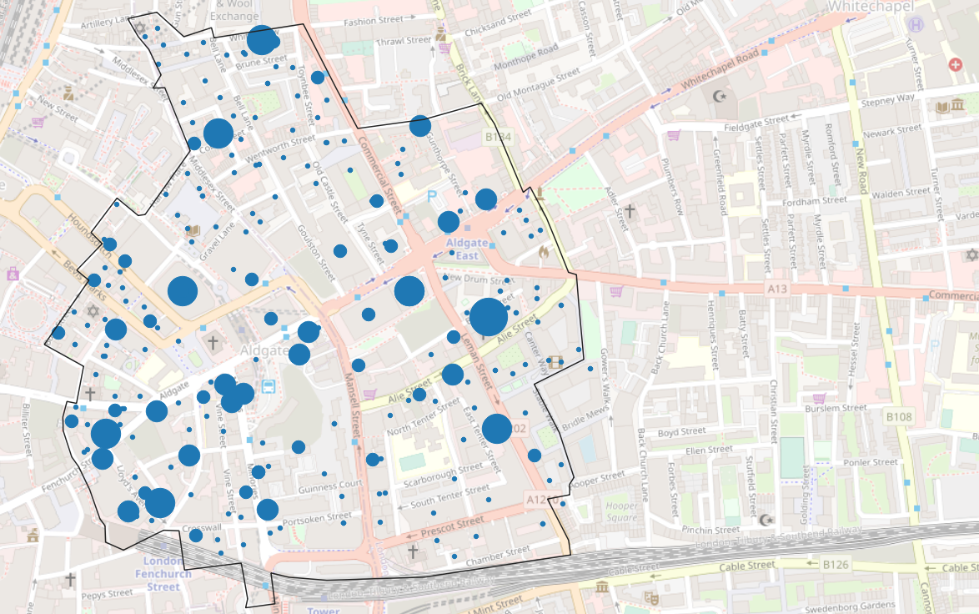
Companies house data top employment sectors
Table 2 - Aldgate Businesses Active and Registered, 2020
Sector | Number of Companies | % BID Total
Office administrative; office support and business support activities | 383 | 9.2%
Real estate activities | 314 | 7.5%
Activities of head offices; management consultancy activities | 307 | 7.4%
Financial service activities; except insurance and pension funding | 301 | 7.2%
Computer programming; consultancy and related activities | 300 | 7.2%
Total | 4,174 | 100%
Companies House data from October 2020 has been analysed to identify the types of businesses registered to addresses within or immediately adjacent to Aldgate and, consequentially, the types of businesses operating in Aldgate. This provides a more holistic and detailed view of the type of business supported in the BID.
Currently, there are 4,174 active and registered businesses in the area covering a variety of different sectors including Financial Services, IT and Food and Beverage.
A breakdown of 2 digit SIC codes shows that the following were the top industries currently registered:
Office administrative; office support and other business support activities
Real estate activities
Activities of head offices; management consultancy activities
Please note that companies can be classified under more than one SIC code and, in this instance, the Primary SIC code has been analysed. Figure 11 maps the location of Aldgate’s active businesses, by six-digit postcodes. As one would expect, there is a large cluster of business in the south west corner of Aldgate, the zone located within the City of London Financial District. However there are also a number of other postcodes which support large clusters of businesses in the north and east of Aldgate, illustrating that employment is not solely supported within the proportion of the BID within the City.
As of 2020, the top three sectors accounted for 24.1% of the total registered businesses in Aldgate with Office administrative activities accounting for the largest of these at 9.2% (Table 2).
Companies House data also shows the number of new active companies created each year. In 2019 and 2020, 607 and 155 new active companies respectively were newly registered to addresses in Aldgate. The new companies are within similar industries to those which are already located in the area. The top business growth sectors for 2019 were:
Real estate activities
Financial Services excluding insurance and pension funding
Other personal service activities (examples and not limited to: laundrette, dry cleaners, hairdressers and other beauty treatments, massage salons, tattooing and piercing studios and funeral directors).
Office administrative; office support and other business support activities
Activities of head offices; management consultancy activities & food and beverage activities.
The top five growth sectors account for 46.3% of all businesses growth in Aldgate in 2019.
The analysis of the Companies House data broadly aligns with the BRES analysis undertaken earlier in the report; namely that Aldgate is a major employment hub across the City, with a high concentration of businesses in high value sectors such as financial services and management consultancy services, and their associated support services e.g. office administration.
The large proportion of companies within the real estate sector is also a likely reflection of the residential population located within the proportion of the Aldgate BID in Tower Hamlets, and the requirement here for Estate Agency services.
Figure 10 - Total number of active, non-dormant companies registered to local six-digit postcodes (2020)
Source: Companies House
Background Map: OS

Slide 15
New Businesses and Business survival rates active enterprises
Table 3 - Active Businesses in 2015 and 2018 (selected geographies)
A further indication of an area’s business environment is the number of enterprises present, and the business survival rates of new entries to the market. This data is only collected at the local authority level by the ONS, and it has not been possible to disaggregate this further. Despite this, analysis of the City of London and Tower Hamlets data against comparator geographies is still a useful exercise in understating the wider context of the environment in which Aldgate is located.
The City of London and Tower Hamlets have amongst the highest concentrations of businesses of any part of London. Table 3 shows the number of active enterprises in 2015 and 2018 across selected geographies.
In 2018, the City of London had the 3rd highest number of active enterprises in London at 31,440, increasing from 26,130 in 2015 or a 6.4% CAGR. Concurrently Tower Hamlets had the 7th highest number of active enterprises in London at 20,795, increasing from 18,390 in 2015 or a 4.2% CAGR.
Despite the strong overall growth in new enterprises, new business entries into the City of London have a lower survival rate than other geographical areas, including Tower Hamlets. Table 4 shows the 1-3 year survival rates of enterprises across different geographies.
The data shows that 75.2% of City of London businesses remain open after their first year, 11.2 percentage points and 14.5 percentage points lower than the London and England averages respectively.
The 2 year survival rate in the City of London is again lower than that of all other geographic areas observed, and the difference in geographical performance continues to diverge across the 3 year survival rates with only 35% of businesses in the City of London surviving compared to over 50% for London and England as a whole.
In comparison, the survival rates of businesses across Tower Hamlets is broadly in line with the London and national figures. However, in terms of the Aldgate BID, it has already been established that those areas within the City of London are the core employment hubs, employing just under two thirds of workers. A greater weighting should therefore be placed on the business survival rates recorded for the City of London rather than Tower Hamlets.
There are many reasons why a start-up may fail, ranging from funding issues, a lack of product-market fit, or poor management. Within the City of London, the lower than average survival rate is likely to reflect the higher sunk costs faced by new businesses (e.g. higher rent and business rates), reducing their operating margins. For instance, according to data from the Valuation Office Agency, the rateable value per sqm in the City of London, which business rates are directly derived from, was £306 in 2015. This is greater than the Inner London average rateable value of £261, the London value of £193, and the England and Wales value of £80. The divergence helps to illustrate the operating margin pressures SMEs and new entrants to the market may face in the City in particular.
That said, the data is also thought to be skewed by the simple fact that so many businesses attempt to “make it” in London. Given the current economic climate as a result of the Covid-19 pandemic, these survival rates are expected to deteriorate when updated data is published.
Geography | Active Enterprises (2015) | Active Enterprises (2018) | CAGR, 2015-2018 %
City of London | 26,130 | 31,440 | 6.4%
Tower Hamlets | 18,390 | 20,795 | 4.2%
London | 541,310 | 612,860 | 4.2%
England | 2,347,740 | 2,586,645 | 3.3%
Table 4 - Businesses Survival Rates registered in 2015 (selected geographies)
Geography | 1 year survival, % | 2 year survival, % | 3 year survival, %
City of London | 75.2% | 60.3% | 35.0%
Tower Hamlets | 86.5% | 67.3% | 51.4%
London | 86.4% | 68.2% | 51.8%
England | 89.7% | 71.4% | 55.2%
Source: Office for National Statistics, Business Registry

Slide 16
Output gross value added and tax revenue
Figure 11 – %, Breakdown of Aldgate GVA in 2018
Gross Value Added (GVA) is a measure of goods and services produced within any given geographical area, and is the primary metric of the economic value generated by an area.
GVA data is unavailable at a more detailed geography than local authority level. Aldgate’s output has therefore been estimated by combining the GVA per worker by sector for the City of London and Tower Hamlets, with the employment by sector for the Aldgate BID (calculated earlier in this report).
Based on this approach, the estimated total GVA of Aldgate is £6.0 billion in 2018 as shown in Figure 11. This equates to an average GVA per worker in Aldgate of £126,490, higher than the average for Tower Hamlets (£116,322) and significantly greater than that for London as a whole (£87,259). This is illustrated in Figure 12.
In relation to the GVA generated by the City of London and Tower Hamlets as a whole, Aldgate accounts for 6.0% and 5.2% respectively of the total. This is in line with the BID’s relative proportions in terms of surface area and total jobs supported.
The sectors which generated the most GVA for Aldgate in 2018 were:
Financial & insurance
Professional, Scientific and Technical
Information and Communication
The three sectors contributed approximately 73% of Aldgate’s GVA in 2018, again highlighting their importance to the area and the high value nature of their services.
Tax revenue
Further analysis has been undertaken into the amount of GVA which accrues to the Treasury in the form of taxation.
The proportion of national income (i.e. total GVA) that accrues to the Treasury in the UK was estimated to be approximately 37% by the Institute for Fiscal Studies (IFS). Other publications has placed the figure between 30% - 40%. The main types of taxation are: Income Tax, National Insurance contributions and VAT which account for approximately two thirds of total taxation collected by the UK Government.
Using the IFS figure of 37%, it can be estimated that Aldgate generated £2.2 billion in tax revenue in 2018.
£6.0 bn GVA
Figure 12 - £, GVA per worker in 2018 (selected geographies)
Source: WSP Calculation based on GVA and Number of Employees (previous calculations)

Slide 17
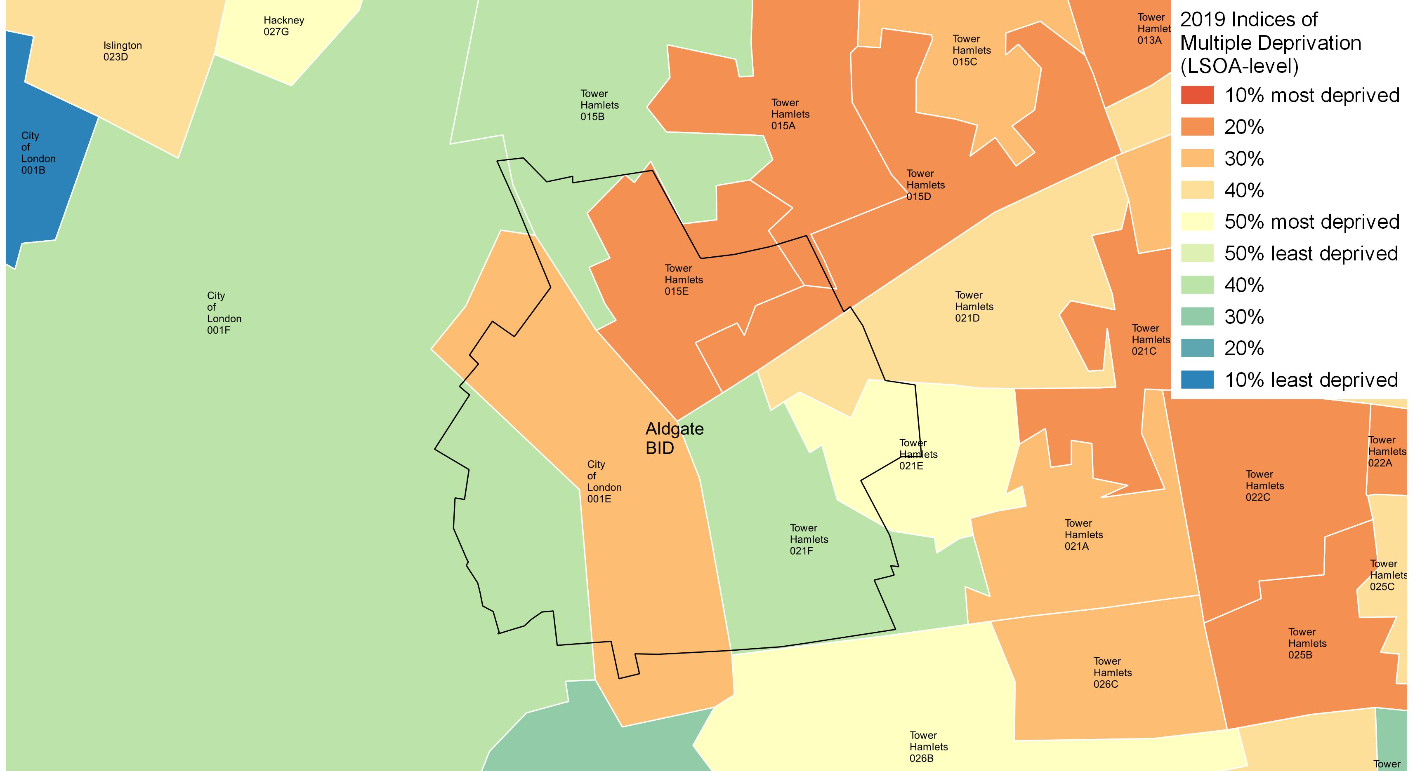
deprivation index of multiple deprivation
Figure 13 - Indices of Multiple Deprivation, 2019, London
The Index of Multiple Deprivation 2019 (IMD) is the official measure of relative deprivation in England published by the Ministry of Housing, Communities and Local Government. It ranks all small areas (LSOAs) from 1st (most deprived) to 32,844th (least deprived) on seven distinct domains. The following are the domains with their respective weighting in brackets.
Income (22.5%)
Employment (22.5%)
Health Deprivation and Disability (13.5%)
Education, Skills Training (13.5%)
Crime (9.3%)
Barriers to Housing and Services (9.3%)
Living Environment (9.3%)
Figure 13 maps the overall IMD ranking of LSOAs in Central London and Tower Hamlets by decile, with the Aldgate boundary superimposed over. The different colours represent the different deciles of overall deprivation, with blue and green the least deprived, and red the most.
The map shows that across the nine LSOAs which cover Aldgate, there are notable variations., with some pockets, particularly in the north east suffering from high levels of deprivation. Indeed the LSOAs of Tower Hamlets 015E, 015D and 015A are within the 20% most deprived neighbourhoods in the county, while City of London 001E, which covers the middle band of Aldgate is within the 30% most deprived neighbourhoods.
Conversely areas to the south east (Tower Hamlets 021F) and west (City of London 001F) perform much better, and are within the 30% least deprived neighbourhoods.
There are also variations across the different domains (see Table 5). While the relative scoring across the income, employment, education and health domains broadly correlates to the overall ranking, all nine LSOAs score considerably worse in terms of the barriers to housing and the living environment domains.
The barriers to housing domain measures the physical and financial accessibility of housing and local services. The LSOAs poor ranking, which places them amongst the most deprived neighbourhoods in the country, is a likely reflection of the minimal housing offer in those zones within the City, as well as the significantly higher average house prices when compared to the national average.
Concurrently, the living environment domain measures the quality of the local environment. With minimal green space and high levels of congestion compared to other neighbourhoods in England, it is not surprising that the nine LSOAs also score poorly in this regard, given the built up nature of the area. A further observation is that Tower Hamlets 015A, is within the bottom 10% in England in terms of the crime domain, a concern for this neighbourhood.
Taken together, it can be said that the Aldgate, and the LSOAs it falls within, has a mixed performance in terms of the deprivation data, with some notable pockets of deprivation in the north east.
Furthermore, the average IMD decile rank across the nine LSOAs which cover the BID equals 4.3. This compares to an average of 5.1 across all LSOAs in London, illustrating that Aldgate underperforms London as a whole in terms of the IMD deprivation data.
Table 5 - Index of Multiple Deprivation, 2019, LSOAs in the Tower Hamlets
LSOA | Overall | Income | Employ-ment | Education, Skills & Training | Health Deprivation & Disability | Crime | Barriers to Housing & Services | Living Environ-ment
City of London 001E | 3 | 2 | 3 | 4 | 6 | 10 | 1 | 3
City of London 001F | 7 | 10 | 10 | 10 | 8 | 10 | 1 | 1
Tower Hamlets 015A | 2 | 2 | 3 | 8 | 3 | 1 | 2 | 1
Tower Hamlets 015B | 7 | 8 | 10 | 7 | 8 | 7 | 2 | 1
Tower Hamlets 015D | 2 | 2 | 2 | 5 | 2 | 3 | 2 | 2
Tower Hamlets 021D | 4 | 5 | 9 | 9 | 7 | 2 | 2 | 1
Tower Hamlets 021E | 5 | 4 | 9 | 6 | 7 | 4 | 2 | 2
Tower Hamlets 021F | 7 | 8 | 10 | 8 | 7 | 9 | 3 | 1
Tower Hamlets 015E | 2 | 2 | 3 | 5 | 3 | 3 | 2 | 1
Source: MHCLG

Slide 18
education Aldgate’s skill level
Table 6 – Education attainment for selected geographies, 16-64
Geography | Tower Hamlets | London | Great Britain
NVQ4 and above | 60.5 | 54.2 | 40.3
NVQ3 and above | 70.5 | 67.0 | 58.5
NVQ2 and above | 79.8 | 78.5 | 75.6
NVQ1 and above | 82.0 | 85.0 | 85.6
No Qualifications | 9.7 | 6.7 | 7.7
In order to develop a rounded understanding of the socio-economic profile of Aldgate, consideration also has to be made of the ‘supply side’ characteristics of the area, and specifically the skill levels and qualification attainment of the resident population.
Unfortunately, data on skills and qualification attainment is only collected at the local authority level by the ONS, and it has not been possible to disaggregate this further. Moreover, given the low residential population found within the City of London, data on skills and attainment is not published for the City of London either. Despite this, analysis of the Tower Hamlets data against comparator geographies is still a useful exercise in understanding the wider context of the environment in which Aldgate is located.
Table 6 illustrates the proportion of Tower Hamlet’s population who hold certain levels of qualifications. The key areas to observe in terms of determining the skill level of a local labour market is the proportion of people with ‘No qualifications’, ‘NVQ2’ and ‘NVQ4 and above’ qualifications.
Higher levels of qualifications generally correspond to higher employment rates with people with degree-level qualifications or above more likely to be working in ‘professional’ and ‘technical’ roles where the median gross weekly earnings are higher. According to the last census; fewer than half of those with “no qualifications” were in some sort of employment compared to roughly 80% of people who had at least one qualification.
The data for Tower Hamlets illustrates that while the borough has a higher proportion of residents with NVQ2 level qualifications or above, it also notably has a higher percentage of people with no qualifications at all. Digging deeper into the data reveals that Tower Hamlets has the second highest proportion of people aged 25-64 with no qualifications across London (10.7%). This is illustrated in Figure 14.
The key takeaway therefore is that while there are a high proportion of residents within Tower Hamlets who are highly skilled, and are therefore likely to be employed in higher skilled occupations, there is also a significant pocket which hold no qualifications and are likely to be working in lower value roles, or who are unemployed.
Views garnered from our consultations with the Board members back this up, specifically that there are areas within Aldgate that suffer from high levels of deprivation, where the resident population are disconnected from the area’s high value employment offering, and where there is consequentially a lack of integration between the resident and working population. Bridging this gap will be important in raising Aldgate’s overall economic performance.
Figure 14 – Tower Hamlets has a large proportion of 25-64 year olds who have no qualifications
Source: NOMIS

Slide 19
accessibility transport and mobility
Figure 15 – Aldgate and nearby London Underground Stations by total annual passenger entries and exits (2019)
Aldgate is extremely well-connected, with three of London’s busiest tube stations - Aldgate East, Aldgate and Tower Gateway - all falling within the boundaries of the BID area. Tower Hill and Liverpool Street are also close to the BID boundary.
These stations give the area direct access to six underground lines – Central, Metropolitan, Waterloo and City, District, Circle, and the Docklands Light Rail. Figure 15 maps the tube stations located within the BID and in the vicinity, by total annual passenger entries and exits.
In addition, Aldgate is also in close proximity to Liverpool Street, which is a terminus of the West Anglia Main Line to Cambridge, the Great Eastern Main Line to Norwich and the Stansted Express, as well as London commuter services to destinations including Hertford, Chelmsford and Southend.
These transport links, and the BID’s level of accessibility is a key driver of development density and employment growth. Areas with the highest levels of accessibility can support the most economic activity.
A further way of measuring the level of accessibility in an area is using the Transport for London’s (TfL) Public Transport Accessibility Level (PTAL) rating system, whereby areas of 100 metres by 100 metres are assigned a rating of between 1a (low) and 6b (high) in terms of the quality of their public transport infrastructure.
Figure 16 shows that the PTAL score for nearly the entirety of the Aldgate BID was 6b (the highest rank),with a small section bordering Whitechapel rated 6a. This suggest that while Aldgate’s accessibility levels are high relative to the average London neighbourhood, there is room for improvement to its public transport provision.
Background Map: OS
Figure 16 – PTAL Score across Aldgate, compared to surrounding areas
Background Map: OS
Source: Transport for London

Slide 20
accessibility transport and mobility
Figure 17 – Annualised Entries and Exits by Local Station- 2007-2019
Aldgate and Aldgate East London Underground stations fall within the area covered by the Aldgate BID boundary. Tower Hill and Liverpool Street are also less than a 500 metre walk from the area, along with Tower Gateway DLR station.
Liverpool Street is one of London’s busiest stations and the busiest station in the City of London, with 67.2 million total passenger entries and exits in 2019- marginally more than Bank and Monument. Tower Hill, Aldgate and Aldgate East by comparison had, respectively, 20.6 million, 10 million and 14.1 million total passenger entries and exits in the same year.
Figure 18 shows that for the four nearest stations to the BID boundaries, overall entries and exits have not changed dramatically since 2007. Liverpool Street has experienced a minor decrease in passenger numbers since its peak of 73.6 million passengers in 2014, while Aldgate and Aldgate East have experienced a respective 65% and 58% increase in total passengers over the period 2010 to 2019.
Figure 18 demonstrates that, in spite of the recent diversification of uses in the City of London and the push towards a weekend economy, passenger numbers at local London Underground stations still drop considerably at weekends.
Of the four local stations, Aldgate experiences the biggest drop in station entries between weekdays and Saturday, with Saturday entries numbering only around 36% of weekday entries in 2019. Comparatively, in 2019 Tower Hill Station experienced the smallest average change in passenger numbers over the weekend of the four stations (and of all Underground Stations in the City of London), with Saturday station entries 86% of total average weekday entries. This can be partly explained by the station’s proximity to the Tower of London and its associated tourist footfall, as well as the large residential populations in Tower Hamlets and Southwark which are served by the station.
In terms of passenger numbers over the course of 2020, all four stations have (predictably) seen a significant drop in both weekday and weekend entry and exit numbers. The impact of the pandemic has slightly varied, however, across the four local stations within Aldgate.
TfL data shows that total passenger entries at Liverpool Street Station for equivalent Mondays before and during the national government’s lockdown slumped considerably from 176,905 entries on January 20 to 40,887 total entries on September 1 (a 76% fall). When the gap in relative entries for the two days is also compared for Aldgate, Aldgate East and Tower Hill, the drop in weekday entries and exits is broadly consistent at about 20% to 23% of the January figures.
However, the disruption to passenger numbers on weekends varies significantly by station, with entries and exits for Aldgate at 42% of January figures in September, compared to 33% for Tower Hill.
Figure 18 – Average number of weekday/weekend entries by Local Station by year
Source: Transport for London

Slide 21
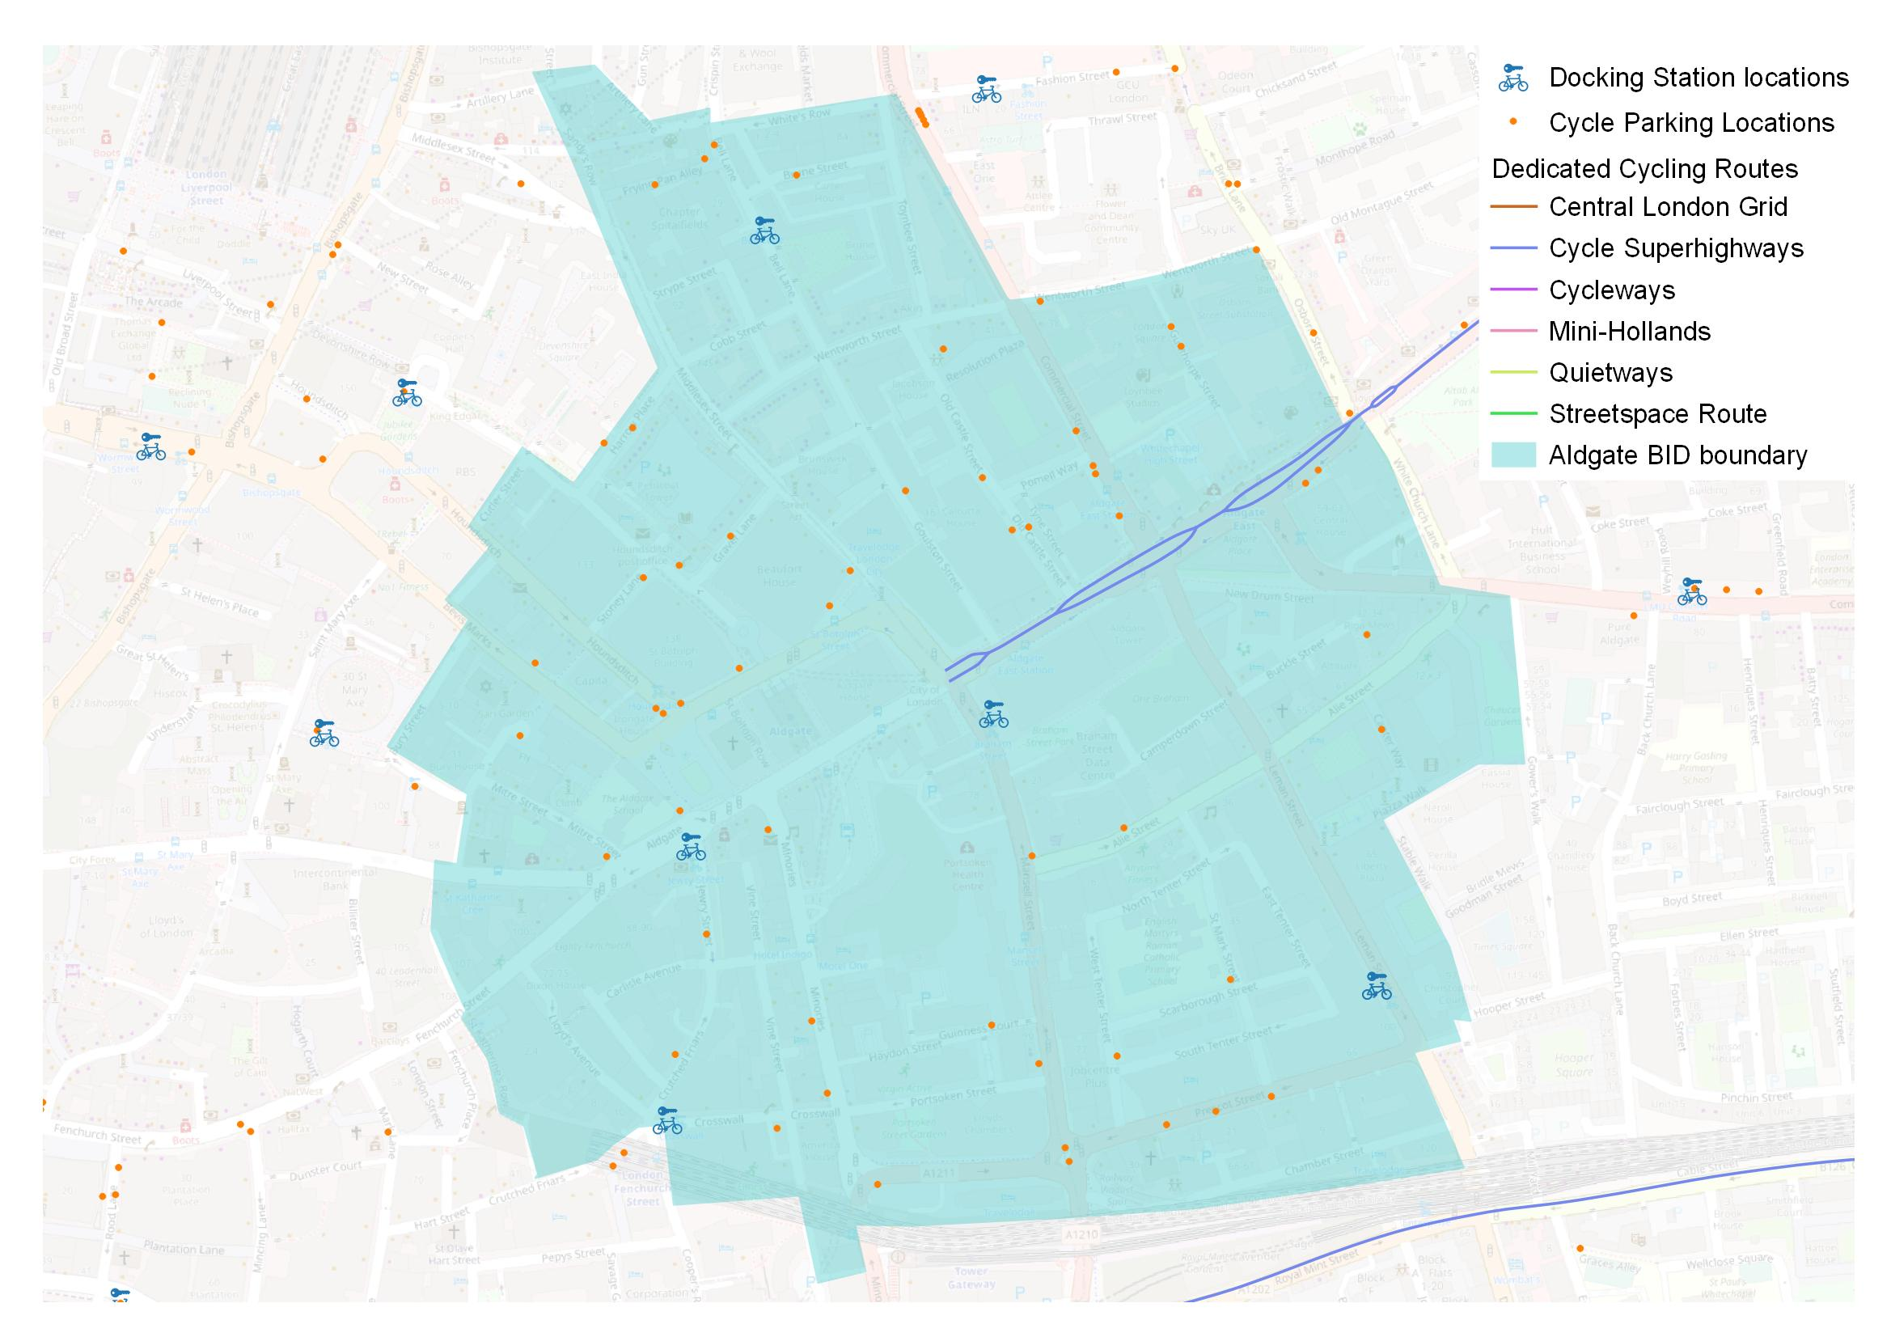
accessibility transport and mobility
Figure 19 – Local Cycling Infrastructure in and around the Aldgate area
The Aldgate BID area is relatively well-served by infrastructure to enable cycling and car-free commutes.
As shown in Figure 19, there are five TfL Santander Cycles docking stations within the boundaries of the BID area, along with part of Cycle Superhighway 2, which runs along Whitechapel High Street westward to the junction with Middlesex Street.
Recent data from the 2 to 8 September 2020 on usage of TfL Santander Cycles suggests that journeys from local docking locations to a second location are as common as journeys from other locations to local docking stations. During this period there were a total of 2,457 journeys from local stations and 2,535 journeys from other London locations to the five local docking stations.
Figures for the 4 to 10 September 2019 (a period of relative normality in terms of the number of workers travelling to the City) show a varied picture when compared to the September 2020 figures, depending on the docking station.
2020 cycling trips to and from the docking station at Crosswall (by Fenchurch Street railway station) were only 55% of the total trips for the equivalent week in 2019. Whereas trips to and from Braham Street docking station (by Aldgate East underground station) and Leman Street docking station in the week of 2 to 8 September 2020 were, respectively, 8% and 24% higher than the equivalent 2019 figures. Trips to and from Bell Lane docking station, near Liverpool street, also increased in 2020.
The increase in bicycle docking numbers in certain locations in the BID area and the relative decline in others suggests that despite increased competition from dock-less cycling providers, such as Lime and Uber, it’s not straightforwardly obvious that TfL Santander Cycles are experiencing a large-scale decline in popularity (at least in the BID area).
The London-wide uptick in cycling as an alternative to other forms of public transport and the increase in the residential population of the BID area since 2019 can possibly explain the uptick of bike rentals away from the BIDs business clusters.
Improving and enhancing local cycling infrastructure is a major priority of Aldgate Connect. Concurrently with the publication of this report, the Aldgate BID has commissioned Steer to produce a far more extensive audit of local cycling infrastructure than presented here. The document is available to download from Aldgate Connect’s website and sets out and extensive “project bank” of possible policy interventions to improve the cycling experience for workers, residents and tourists in the area.
Background Map: OS
Source: Transport for London

Slide 22
4. Development pipeline

Slide 23
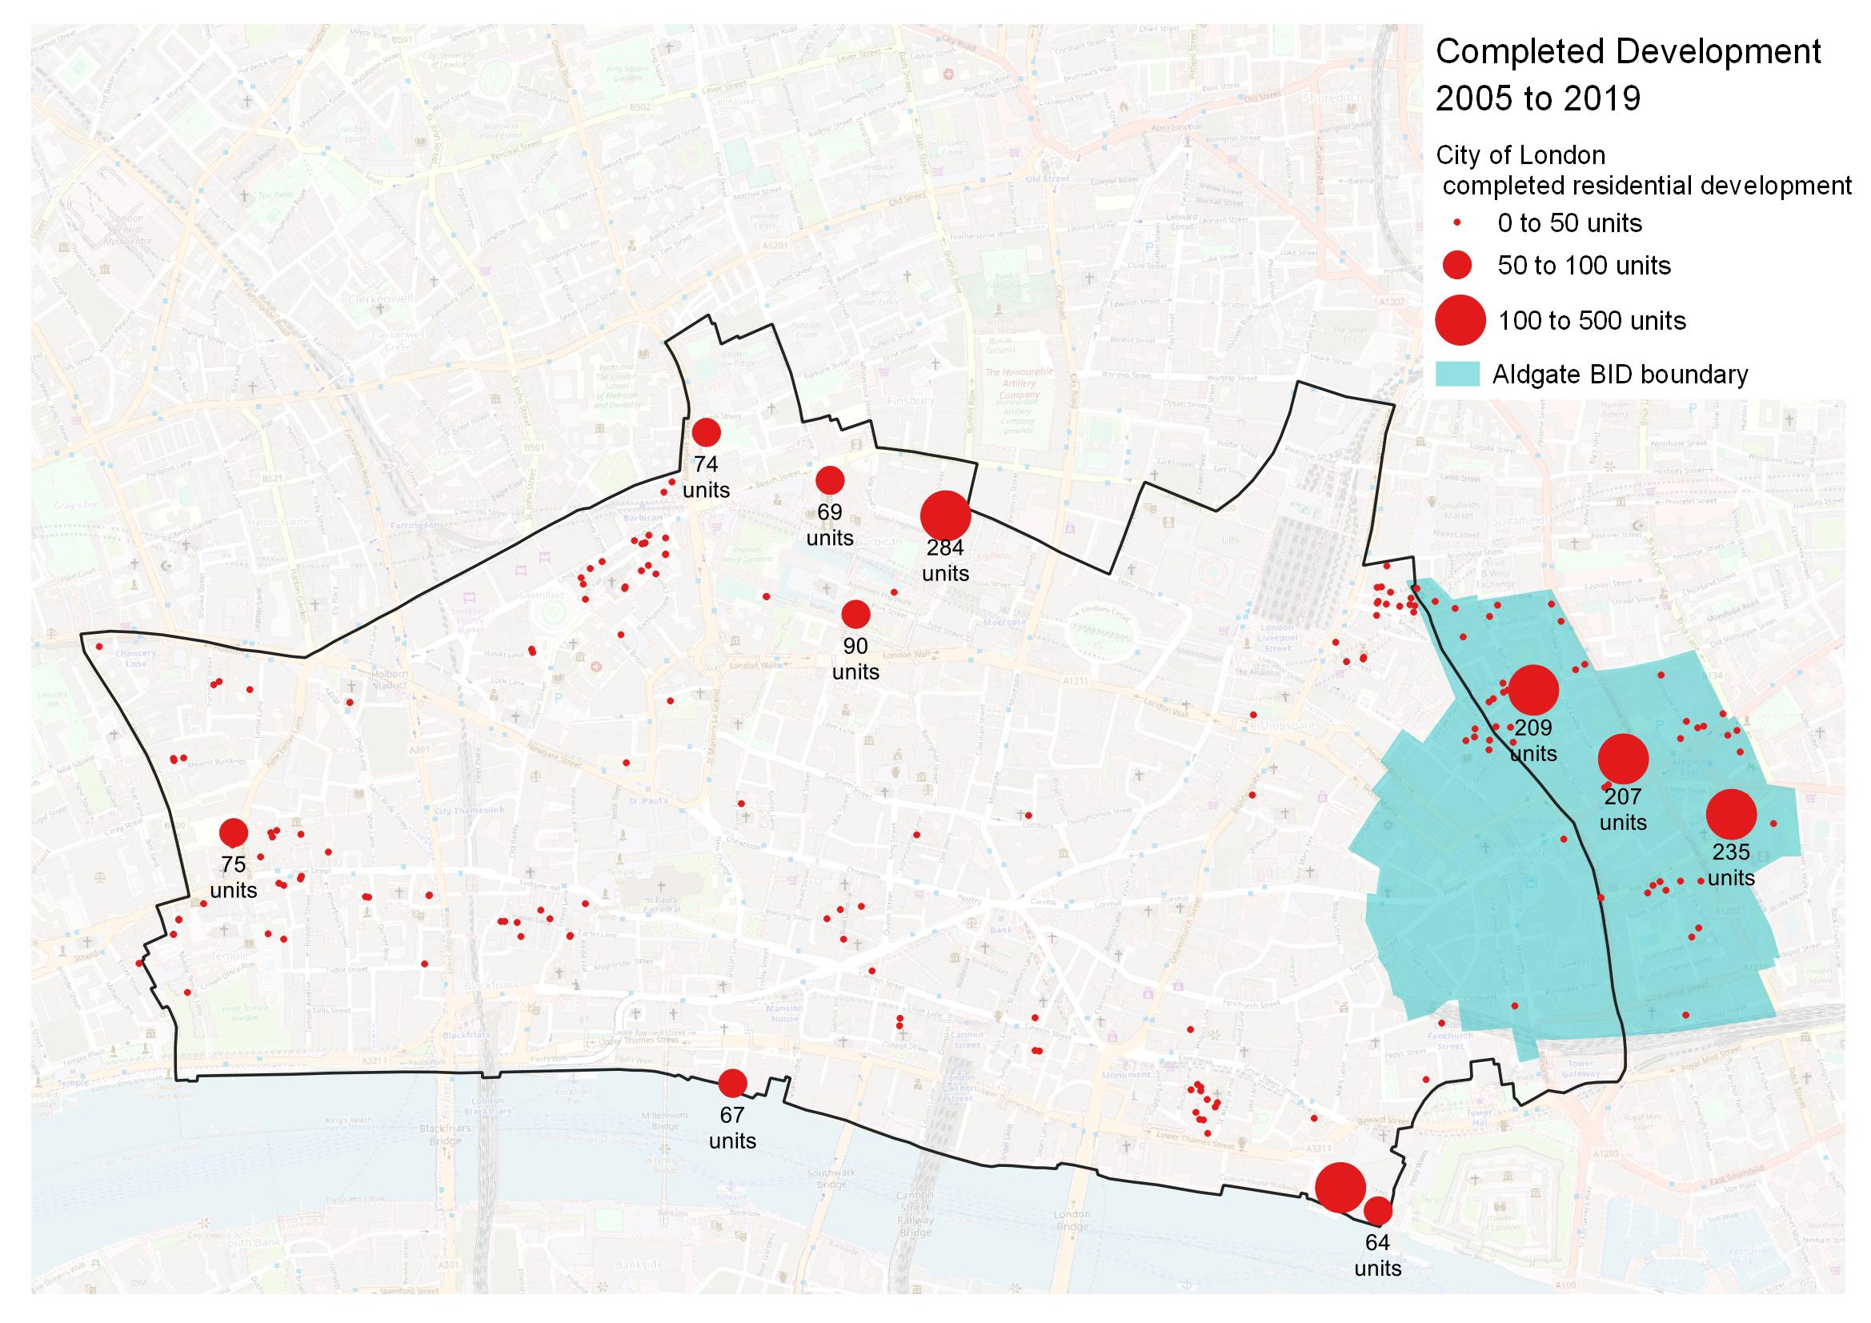
DEVELOPMENT PIPELINE HISTORIC & FUTURE residential DEVELOPMENT
Figure 20 - Completed Residential Development (2005 to 2019) by total number of new residential units
The area within the Aldgate BID has seen the most substantial residential growth of any Business Improvement District in the City of London.
As shown in Figure 20, London Development Database data shows that over the period from 2005 up to August 2019, across the City of London the majority of completed large-scale residential development has occurred in the area on the northern boundary with the London Borough of Islington (around Barbican and Moorgate stations), with a few one-off developments around Fleet Street and Tower Hill.
While a relatively minimal amount of residential development has occurred over this period within the City of London portion of the Aldgate BID area, the Tower Hamlets section of the area has seen the completion of several major residential developments. 2014 saw the completion of the Relay Building next to Aldgate East station, which in addition to commercial space provided 207 new units. 2014 also saw the completion of 61-75 Alie Street - a 7 and 28 storey development encompassing office space and 235 new residential units, of which 27% were affordable. Equally in 2015, the 209 units of the Holland Estate on Commercial Street were refurbished, which included the replacement of 43 units.
Over the period 2005 to 2019, a net total of 38 residential units were built in the City of London portion of the Aldgate BID area. In the Tower Hamlets portion of the BID area, a total of 931 new units were completed during this period and 91 demolished (840 net units).
Based on 2019 estimates for borough-wide averages for residents per household, a high-level estimate suggests that around 2,297 new residents could have moved into the 878 net additional residential units built in the BID area over the period 2015-2020.
Background Map: OS
Source: London Development Database

Slide 24
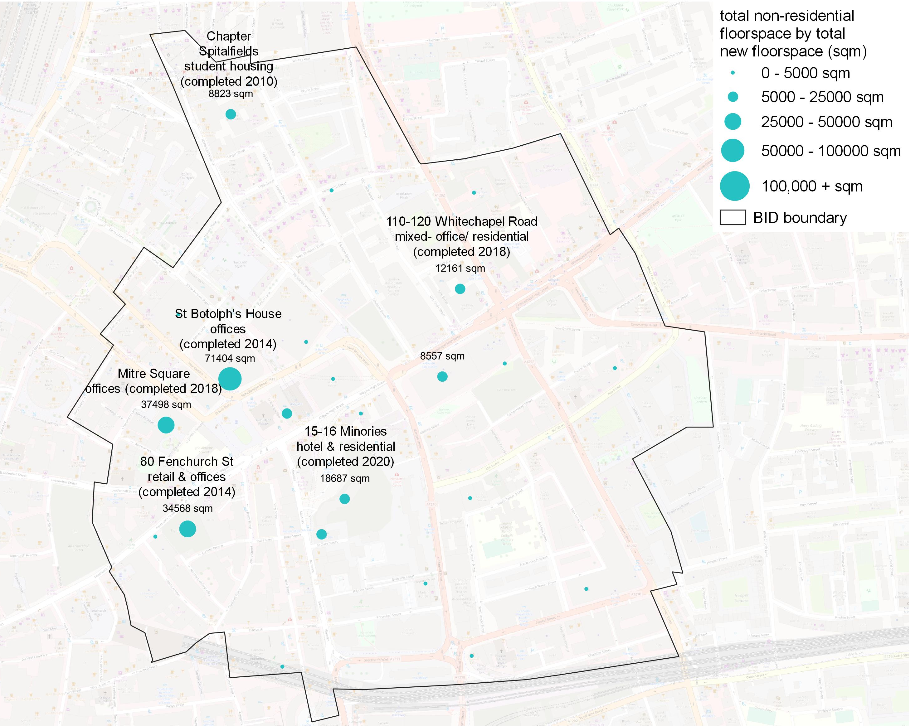
DEVELOPMENT PIPELINE HISTORIC & FUTURE COMMERCIAL DEVELOPMENT
Figure 21 - Completed development within the BID area boundary, 2005-2020 by proposed non-residential floorspace (sqm)
In recent years, there have been a number of large-scale commercial developments within Aldgate, as shown in Figure 21.
The 2000s saw a wave of office development in the western part of Aldgate on the fringes of the City’s insurance and financial service hubs. Two major office-space led developments were completed in 2014 at 80 Fenchurch Street and St Botolph’s House, with the 37,000 sqm Mitre Square development completed in 2018.
Elsewhere in the area, other large-scale development included Chapter Spitalfields on the northern fringe of the area, which saw the delivery of 8,800 square metres of new office accommodation alongside 35,600 square metres of new student accommodation in a 35-storey block. Equally a mixed office-hotel development at 15-16 Minories- adjacent to Aldgate Bus Station- has recently topped-out (as of November 2020) and will be home to a new Canopy by Hilton Hotel.
In net terms, a total of 121,000 sqm of additional non-residential space has been constructed over the period 2005-2019. When applying the former Housing and Communities Agency’s Employment Density Guidance, this is anticipated to have generated between 4,200 and 5,000 additional full-time equivalent jobs in all industries. Of these additional jobs, between approximately 3,900 and 4,600 would be jobs associated with professional services and financial services jobs.
Background Map: OS
Source: London Development Database

Slide 25
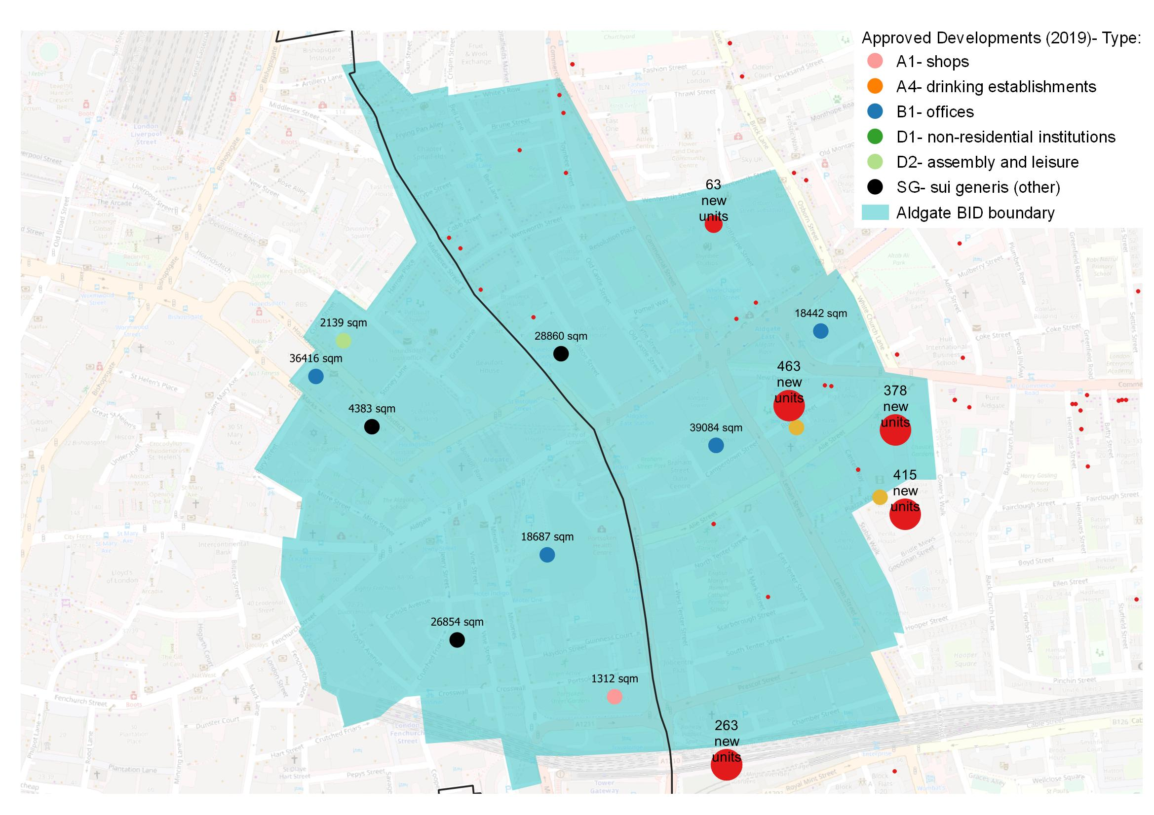
DEVELOPMENT PIPELINE HISTORIC & FUTURE COMMERCIAL DEVELOPMENT
Figure 22 - On-going development with planning permission by primary use and proposed floorspace (sqm)
The area within the Aldgate BID has a very high density of forthcoming planning applications.
As shown in Figure 22 London Development Database data shows that as of August 2019 there were a large number of approved developments waiting to start or complete, which fell within the BID area boundary. Unlike other parts of the City, the proposals encompass a mix of residential, student accommodation and commercial projects and reflects the increasing diversification of uses in this corner of the square mile.
A number of large-scale student accommodation projects are planned for the area. 16-22 Middlesex Street will see the provision of more than 28,000 sqm of additional student housing upon completion; 4-6 Middlesex Street on the Tower Hamlets side will see the delivery of 913 rooms in a part-16 storey, part-24 storey block; and Urbanest Vine Street will see a mix of student accommodation for students at King’s College London, along with commercial space for SMEs and retail when completed in 2021.
In addition to student accommodation, the area has seen a large number of applications for new office space, which are somewhat evenly distributed across the area, with proposals in both the City and Tower Hamlets. The redevelopment of Bevis Marks House will see a 19-storey commercial building with ground floor retail; and two major office refurbishment schemes have been approved for sites close to Aldgate East station, including 18,442 sqm of space at 59-63 Whitechapel High St.
A substantial amount of new residential development has been approved for sites in the BID area. A total of 1,006 residential units have been approved for the Tower Hamlets portion of the BID area and 107 residential units have been approved for the City of London portion of the BID area, with 87 of these units delivered as part of the 15-16 Minories development.
Other major residential developments in the pipeline as of 2019 or completed in 2020 include the 463-unit Aldgate Place (since completed) and additional stages of Berkeley Homes’s mixed use Goodman Fields development, with a further 378 units completed as of 2020.
In addition, as of January 2021, plans for a 19-storey office building at 33 Creechurch Lane are soon to be decided on and revised plans for a large-scale office development at 101 Whitechapel High St are expected to be submitted for review imminently.
Background Map: OS
Source: London Development Database

Slide 26
5. Key challenges and opportunities

Slide 27
Covid-19 economic impact
At the time of writing (November 2020) the size of the UK economy, despite recording monthly GDP growth across the summer months, remains 8% below its pre Covid-19 levels, a direct consequence of the record output fall in 2020q2.
The short and medium-term economic implications for the Aldgate economy vary greatly across sectors. On the one hand the professional, financial and information/ communication sectors, which were already shifting to more online and remote working, have been able to adapt more easily during the pandemic. For these industries, while some changes to policies and workplace environments may be necessary, output and employment have broadly recovered from the initial shock, albeit perhaps at a higher cost.
Conversely, other sectors are far more vulnerable to a combination of lower footfall and increased costs, resulting from reductions in travel and tourism, possible reductions in domestic consumer spending, and the continuation of social distancing and other policies (imposed or voluntary) designed to reduce the risk of virus transmission.
This is particularly true of Aldgate’s food service offering, which without the Monday-Friday workforce influx has struggled to stay operational. Anecdotal evidence illustrates that small and independent businesses in particular have been impacted, with many still not reopening following their enforced closure in March. This is reflected in the latest GDP data for September 2020, which shows output in hospitality sectors such as accommodation and food services, and the arts and entertainment sectors, remaining over 20% down on their pre Covid-19 levels. Conversely, sectors which have been able to adapt to home working and have not faced severe restrictions to their activities - such as the financial services sector – have seen their output broadly recover. This is illustrated in Figure 23 for the UK as a whole.
Pertinently, while the above analysis reflects the sectoral impact on the economy, it needs to be remembered that these impacts are distributed unequally across households and individuals, with evidence illustrating that the least well off in society are most at risk to the negative consequences. The challenge for these households, in the context of the existing pockets of deprivation present across the BID, will be assessed later.
Figure 23 – UK monthly GVA by sector (Index: September 2019=100)
Source: ONS (Aldgate’s dominant sectors represented by solid lines)

Slide 28
Covid-19 Societal impact and the onset of home working
While the economic impacts of the Covid-19 pandemic are severe, they are expected to be temporary in nature, with most economic forecasts (while shrouded in uncertainty) predicting that the economy will recover within 2-3 years. The recent news regarding the promising developments of several Covid-19 vaccines, should further support this view.
What is perhaps more interesting moving forward are the wider societal changes to the way in which we work and socialise, and the long-term impact this will have on inner city locations such as the Aldgate.
For example, home working is now the (temporary) national and international norm (Figure 24), and this may have far-reaching implications for the future demand for employment space, in particular office space.
Already we are seeing major tech companies such as Twitter and Facebook saying employees can work from home permanently if they want to. The move to remote working – which many have enjoyed and actually have found to be more productive – could see companies use this as an opportunity to downsize, to reduce operating costs and invest more in technology and training. There could also be a structural shift in terms of office locations, with more companies opting for cheaper out-of-town or suburban locations, as opposed to expensive inner-city urban locations. All of this would drastically reduce footfall, particularly in the proportion of Aldgate within the City of London, negatively impacting the vitality of the area.
However, while the pandemic has brought insight into the benefits of remote working, it is unlikely that the age of urbanisation is over. Cities have been important to global economic development. The so-called agglomeration benefits of cities – the way in which, as scale and density increases, output and productivity rises – are well understood. These gains arise because cities (and offices) foster specialisation, learning, relationships, competition and the exchange of ideas. This is particularly important for younger workers, at the start of their careers.
There is also evidence that workers want an office they can attend, be it two or three days a week, as evidenced by the anecdotal pick-up in footfall during September, as well as the TfL passenger data previously assessed. The opportunity to come into the City, to meet colleagues and socialise remains an attraction for many.
What we may see instead therefore, are offices reducing in size – in order to accommodate say 50% of a workforce at any one time - but becoming more attractive and “destinations” in their own right, importing some of the home comforts that we’ve become used to. One school of thought is that we will see the major re-purposing and “hotelization” of large office blocks within Aldgate, with businesses downsizing to say one or two floors with sustainable building designs, more characterful buildings and lower rents, but still retaining an employee hub.
A further possibility, based on discussions with the BID board, could be the rise of workers commuting into the City from out of London, staying a few nights in inner city hotels, before commuting home again. The rise of more City hotels to accommodate a Tuesday – Thursday work week could be an interesting trend to be aware of in the coming years.
Figure 24 – Greater London Google Mobility Report
Second Lockdown implemented
Initial Lockdown implemented
Source: Google Mobility Data – google activity metrics compared to baseline (7 day rolling average)

Slide 29
brexit possible impact on the Aldgate economy
Leaving the EU (in terms of its potential impacts on trade, investment and the availability of labour and skills) remains one of the greatest economic risks to the UK’s business environment and broader economy in the long run. This may seem trivial in the context of the deepest recession in living memory as a result of the Covid-19 pandemic, but this places undue weight on the dramatic, but mostly temporary impacts of Covid-19, compared to the larger, long-term costs of Brexit, which could be expected to accumulate over time.
In December 2020, the UK Government announced that a post-Brexit agreement on trade has been agreed, just a week before the transition period between the UK and the EU ended on the 31 December 2020. While this was welcome and avoids the disruption of a no-deal Brexit in the middle of the Covid-19 pandemic, the agreement is primarily centred around the rules for goods crossing borders. It says far less about trade in services, the dominant sector of the Aldgate, and wider UK economy.
For Aldgate, the impact on the financial services sector, and related activities such as legal services, will be of great concern. Decisions on issues such as equivalence, regulatory alignment and the ability of UK firms to access the single market (often collectively referred to as ‘passporting rights’), as well as the ease with which closely related professionals such as lawyers are able to travel to and from the EU for work, are still to be confirmed, and will be at the forefront of businesses’ minds going into 2021.
Indeed, in the absence of clarity across the transition period, we have already seen companies take action. According to accountancy firm EY, financial services firms operating in the UK have shifted around 7,500 employees and more than £1.2 trillion of assets to the European Union ahead of transition period ending on 31 December, in order to raise their continental presence in the event the UK is not granted equivalence rights. High profile companies which have shifted assets include JP Morgan and Goldman Sachs. This trend is reflected within the Aldgate BID with the number of jobs in the Financial and Professional sector falling by 3,000 between 2015-2018 (see Figure 25). Despite remaining the dominant employer, this reduction is an illustration of the apprehension arising from the uncertain outlook, which remains despite a trade deal being reached.
It should be noted however, that the fall in employment should not be wholly attributed to the impact of Brexit. There is also likely to be an element of how new employment is categorised, with the rise of fintech and legaltech firms blurring the lines between what activities are classified under financial related employment and what is classified under tech.
Away from the financial sector, more generally the importance of foreign workers to London and Aldgate’s economy – both in highly skilled and entry level jobs – cannot be played down. It is estimated that 14% of jobs in London in 2017 were held by workers born in the European Economic Area (EEA) compared to 6% in the rest of the UK . EEA workers play a particularly prominent role in certain industries. For instance they account for over a quarter of jobs in the accommodation and food sector (28%). Any future policy that restricts the free movement of labour from the EU, will have significant impacts on Aldgate’s eco-system.
Figure 25 – Aldgate has seen a significant fall in Financial Services jobs since the EU Referendum vote
Source: BRES and WSP calculations.

Slide 30
Promoting the bid petticoat lane market
Prior to the Covid-19 pandemic, there had been a drive across the BID to promote Aldgate as an attractive leisure and tourist destination, which can be enjoyed 7 days a week by both locals, workers and tourists.
Historically the BID has struggled in this aspect, and often finds its location straddling two local authorities a hinderance when it comes to co-ordinating an integrated approach to marketing the area. Yet Aldgate has much to offer, and with the major tourist hub that is the Tower of London located within its boundary, it already has a major visitor pull factor. The challenge is to capitalise on this and make Aldgate a distinctive cultural destination, through greater promotion and wayfinding initiatives.
Based on our discussions with the BID Board, a main priority and opportunity moving forward will be the regeneration of the historic Petticoat Lane Market. Once the biggest street market in Europe, the market has since lost its way, has reduced in size, and is not the attraction it could be.
As a result, the market does not have the same profile as other London markets such as Borough Market and Camden Market. While reliable data on market footfall is difficult to find, the relative profiles of the markets can be illustrated through Google trends data. Google trends normalizes search data to make comparisons between terms easier, and thus can act as a good proxy for popularity. Comparing the search terms of ‘Borough Market, ‘Camden Market’ and ‘Petticoat Lane Market’ illustrates that throughout the 12 months up until the onset of the Covid-19 pandemic, the former markets have generated considerable more searches than Petticoat. This is illustrated in Figure 26.
There is a realisation amongst members of the BID of the huge appeal and economic value the likes of Borough and Camden market have to their local areas, not just in attracting tourists but for local employment opportunities. Indeed, research undertaken by the GLA indicates that street markets in London support 13,250 jobs and contribute £247.6 million to London’s economy in terms of gross value added, illustrating their importance to Greater London as a whole. In a post Covid-19 world, their importance is only like to increase as the desire for open air shopping grows.
The regeneration of Petticoat Market could strengthen the economic health and social fabric of the area, and has the potential to become the “jewel” within Aldgate. This however will once again require co-ordination between the City and Tower Hamlets local authorities, given the market straddles both areas.
Figure 26 – Google Searches for London Markets (April 2019 – April 2020)
Source: Google Trends

Slide 31
Transport infrastructure Investment is required in Aldgate’s transport infrastructure
The Aldgate area has seen a range of fast paced changes and developments over the last 5 years, as illustrated in the development pipeline section of this report. The introduction of high-rise developments, cutting edge architecture and improved versatile open space; all intermixed with existing cultural and historical sites has contributed to the diverse offering Aldgate has. However, with rapid change and increased footfall, comes increased pressure on transport infrastructure and the public realm. This was an area of concern for the members of the BID board.
As illustrated earlier in this report, the BID is home to two tube stations – Aldgate and Aldgate East. These stations have changed very little from when they first opened over 100 years ago, and according to one Board member have been starved of investment. The result is that compared to other tube stations within London, they feel outdated and to a certain extent run-down and neglected. Moreover, neither station has step free access. One of the Aldgate BID’s major strategic themes is to create an appealing area for Aldgate, recognising the importance that first impressions have on visitors. Regenerating these tube stations would go some way to helping to promote and market the area, encouraging visitors to return, as well as being equally important for residents and workers.
A further theme which arose from our discussions with the Board was the issue of high levels of vehicular congestion within Aldgate. This was further underlined by the Perception Analysis survey undertaken by the BID team in 2019 which found that 68% of respondents noted traffic as an issue within the area. Developing a co-ordinated Traffic Strategy, in conjunction with the City of London, Tower Hamlets and TfL will be imperative to addressing this challenge.
Crossrail
Despite the lack of investment across Aldgate and Aldgate East tube stations, Aldgate is set to benefit from the construction of the Crossrail project. Following a number of delays, Crossrail is now due to open in 2021 and will further improve the transport accessibility of Aldgate, with stations in close proximity at Liverpool Street and Whitechapel. This in turn will provide a greater capacity for growth within Aldgate.
Indeed, Crossrail will significantly decrease journey times from Aldgate to key employment locations and strategic sites such as Heathrow Airport. Table 8 summarises some key journey time savings from Liverpool Street station.
Table 7 – Journey times before and after Crossrail (from Liverpool Street)
Destination | Current Journey Time | Crossrail Journey Time | Time Saved
Heathrow Terminal 2/3 | 52 minutes | 33 minutes | 19 minutes
Canary Wharf | 22 minutes | 6 minutes | 16 minutes
Paddington | 26 minutes | 10 minutes | 16 minutes
Bond Street | 22 minutes | 7 minutes | 15 minutes
Source: Crossrail and TfL

Slide 32
deprivation Aldgate suffers from pockets of high deprivation
As illustrated earlier in the report, the Aldgate BID suffers from pockets of high deprivation, particularly in the north eastern corner, with two of the LSOAs which cover the BID being within the 20% most deprived neighbourhoods in the country. As a result, while Aldgate performs well across a range of economic statistics highlighted in this report, there are still clear issues in terms of the local neighbourhoods’ social and economic wellbeing, particularly in Tower Hamlets. Indeed, the juxtaposition between these areas of high deprivation in residential focussed areas, compared to the zones generating huge economic value within the City’s Financial District are stark, and was raised several times across our discussions with members of the BID Board. Indeed, it was felt that Aldgate’s resident population is disconnected from the area’s employment offering and there is a lack of integration between the residential and working populations.
Raising the profile, prosperity and social wellbeing of these neighbourhoods is a challenge for the BID, and the work of Not for Profit organizations such as Toynbee Hall – who work with Tower Hamlets to tackle the causes and impacts of poverty in the area - will be vital.
Their work is going to be particularly pertinent in light of the economic hardship resulting from the Covid-19 pandemic. Evidence suggests that the economic impact of the pandemic – in terms of loss of work and income – is likely to have had a larger impact on low income households, with a greater proportion of people in these households working in the ‘high risk’ sectors (e.g. hospitality, food and drink, retail). The Institute for Fiscal Studies (IFS) estimates that excluding key workers, most people in the bottom tenth of the UK’s earnings distribution are in sectors that have been forced to shut down and 80% are either in a shut-down sector or are unlikely to be able to do their job from home – compared with only a quarter of the highest-earning tenth. The result is that those are most vulnerable to the impacts of the pandemic, were the least well off to start with. Given the deprivation data evident within Aldgate, it is likely that the BID is home to some of the households which will have been impacted most keenly.
The government’s Job Retention Scheme will have provided support throughout 2020, but ensuring these neighbourhoods and households are supported following its withdrawal will be crucial in the coming year.
Text here
Source: Toynbee Hall
Toynbee Hall works closely with Tower Hamlets to address local poverty and deprivation issues.

Slide 33
technology new technology is reshaping economies as we know them
Aldgate, with Old Street and Tech City to its north, and the Olympic Park and the Royal Docks to its north east and south east respectively, is also part of a fast-developing ‘tech-city quad’. This includes London’s only Enterprise Zone and is therefore also a regeneration priority for London’s Mayor and the Greater London Authority.
Aldgate is therefore in prime position to develop, implement and benefit from the unprecedented speed of technological change which is impacting all sectors of the economy, none more so than the financial and insurance sector, a dominant driving force within the Aldgate BID.
Key technological drivers behind the sector include:
The rise of FinTech and LegalTech start-ups, which, underpinned by customer-friendly solutions and unencumbered by legacy systems, have encroached upon established markets. Focussing on particular innovative technologies or processes, they are challenging the incumbents in all areas from mobile banking (e.g. Monzo, Revolut) and insurance (e.g. Tifgroup), to foreign exchange (e.g. TransferWise). Their work seeks to improve upon the traditional financial services offering, by using new technology to streamline processes and enhance the overall customer experience, thereby digitally disrupting the UK's financial sector, and changing its structural make-up.
Linked to the rise of FinTechs, is the use of Cryptocurrencies, and in particular Blockchain. The list of potential uses of Blockchain is almost limitless, from financial transactions and automated contractual agreements, to tax regulation and equity trading. Several industry groups have already come together to commercialise the technology and apply it to real financial services scenarios. This trend is expected to continue as funding and innovation helps to drive blockchain technology from a largely retail focus to include more institutional uses in the coming years.
There have already been astonishing advances in robotics and AI, machine learning and pattern recognition in recent years, enhancing the productivity and efficiency of firms in the financial sector. Existing applications include risk management analysis, chatbots and virtual assistants, underwriting, fraud detection, and algorithmic trading. However, over the next 10 years, it is expected that there will be shift from standalone uses of these technologies, to full integration into a company’s business-as-usual activities.
The result – as well as the higher value employment opportunities and huge productivity benefits for the area’s employment hubs – is a changing workforce and work patterns. Indeed, while technology provides substantial new enterprise and job creation opportunities, especially in locations where skills and talent are already concentrated, we have seen in recent months that it is also a huge facilitator of remote working.
Striking the balance between attracting workers to Aldgate’s centrally located assets and the desire to find new ways of working will need to be thought through carefully.
Source: American Banker
Technology is not only leading to productivity gains, but changing the way we work.

Slide 34
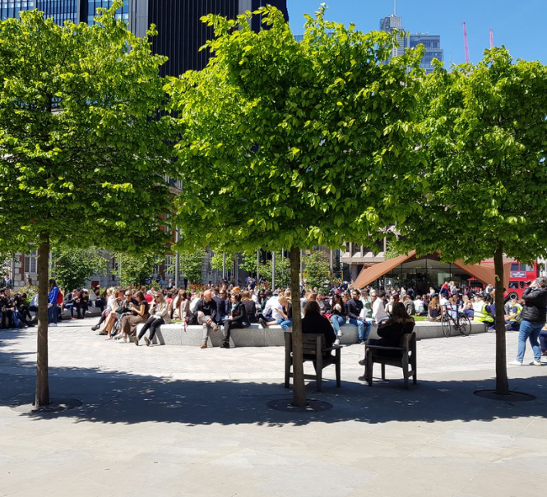
net zero drive to a net zero economy by 2050
The UK Government’s commitment to achieving ‘Net Zero’ carbon emissions by 2050 – now enshrined in law – will have a significant impact on how commercial development as well as transport infrastructure will be planned, delivered and financed within Aldgate.
The drive to a Net Zero emissions target will see real estate within the area undergo significant change, continuing transitions that are already well underway. New residential and commercial buildings for instance, under the guidance of UK Green Building Council (UKGBC), will require significant investment in new sustainable heating and power infrastructure, while there will also be a need for widespread retrofitting of old buildings. These technologies will be driven by new power sources e.g. hydrogen and biomass, but will also require widespread implementation of building management systems, smart systems and demand side response (DSR) systems, generating considerable opportunities and new business for tech companies within the area, and their value chains.
The Net Zero agenda will also provide many opportunities in high-value service sectors, with legal, financial and consulting expertise required when it comes to financing low carbon and Net Zero projects. The Government has said it wants the UK to develop world leading “green finance” capabilities, a growing arm of the UK’s already dominant services sector. The announcement in November 2020 that the UK government will issue its first green bond next year, in a bid to capitalise on growing investor demand for assets that fund environmentally-friendly projects, further underlines this.
Aldgate, with its existing economic base and comparative advantage in professional and financial services, makes it an ideal location for the development of these capabilities.
This has been recognised by the City Corporation who in 2020 unveiled its radical new Climate Action Strategy. The Strategy will invest £68 million to help reduce greenhouse emissions over the next six years, creating 800 green jobs, and in the process make the Square Mile a net zero area by 2040, 10 years earlier than the government’s goal.
The drive to a net zero economy is set to have not only environmental benefits for Aldgate, but commercial benefits too.
There are both environmental and commercial benefits on offer for Aldgate from the drive to a Net Zero economy.

Slide 35
6. conclusions

Slide 36
Conclusions Aldgate connect bid socio-economic profile
The socio-economic baseline study has elucidated the key economic characteristics and profile of the Aldgate Connect BID. The main findings from the report are summarised below:
Compared to other City BIDs, Aldgate has a relatively high resident population of around 8,050 people.
There has been significant growth in Aldgate’s residential population in recent years. In comparison to 2015, the total population has increased from 6,300 to 8,050, a growth rate of 28%.
In 2018, Aldgate supported approximately 47,100 jobs across a range of sectors. When proportioning the number of jobs to their Local Authority, this equates to 29,880 jobs in the City of London (63% of total) and 17,220 in Tower Hamlets (37% of total).
The total number of jobs supported across the BID has risen from 42,690 jobs in 2015, an increase of 4,410 (10.3% or a CAGR of 3.3%).
The dominant sector of employment across Aldgate is the financial and insurance sector, which supports 12,560 jobs, equating to 27% of the total workforce. This is in spite of the sector suffering large declines in employment since 2015, a result many contend of Brexit induced uncertainty.
Aldgate also has a notable concentration of employment in the management consultancy sector (7% of workforce), legal and accounting sector (6%), architectural and engineering activities (6%) computer programming (5%), and food and drink services (5%).
Aldgate generated approximately £6 billion in gross value added (GVA) in 2018, accounting for 6% of total GVA generated in the City of London and 5% within Tower Hamlets.
The high value nature of the services provided is evident in the GVA per worker of £126,490 in Aldgate, significantly greater than that for London as a whole (£87,259).
The Aldgate Connect BID generated an estimated tax revenue of £2.2 billion in 2018.
Aldgate’s role as an employment hub is underlined by its employment density (number of employees per km2) of 93,130. This is significantly greater than the corresponding employment density of Greater London as a whole (3,280).
In terms of deprivation, Aldgate, and the LSOAs it falls within, has a mixed performance, with some notable pockets of deprivation in the north eastern corner of the BID.
Aldgate is extremely well-connected, with two London tube stations - Aldgate East and Aldgate - falling within the boundaries of the BID area. The vast majority of the BID also has the highest PTAL rating of 6b.
In recent years, there have been a number of large-scale commercial developments within Aldgate
In net terms, a total of 121,000 sqm of additional non-residential space has been constructed over the period 2005-2019. This is anticipated to have generated between 4,200 and 5,000 additional jobs.
The area within the Aldgate BID has a very high density of forthcoming planning applications, both commercial and residential based.
Source: Aldgate Connect BID

Slide 37
7. appendices

Slide 38
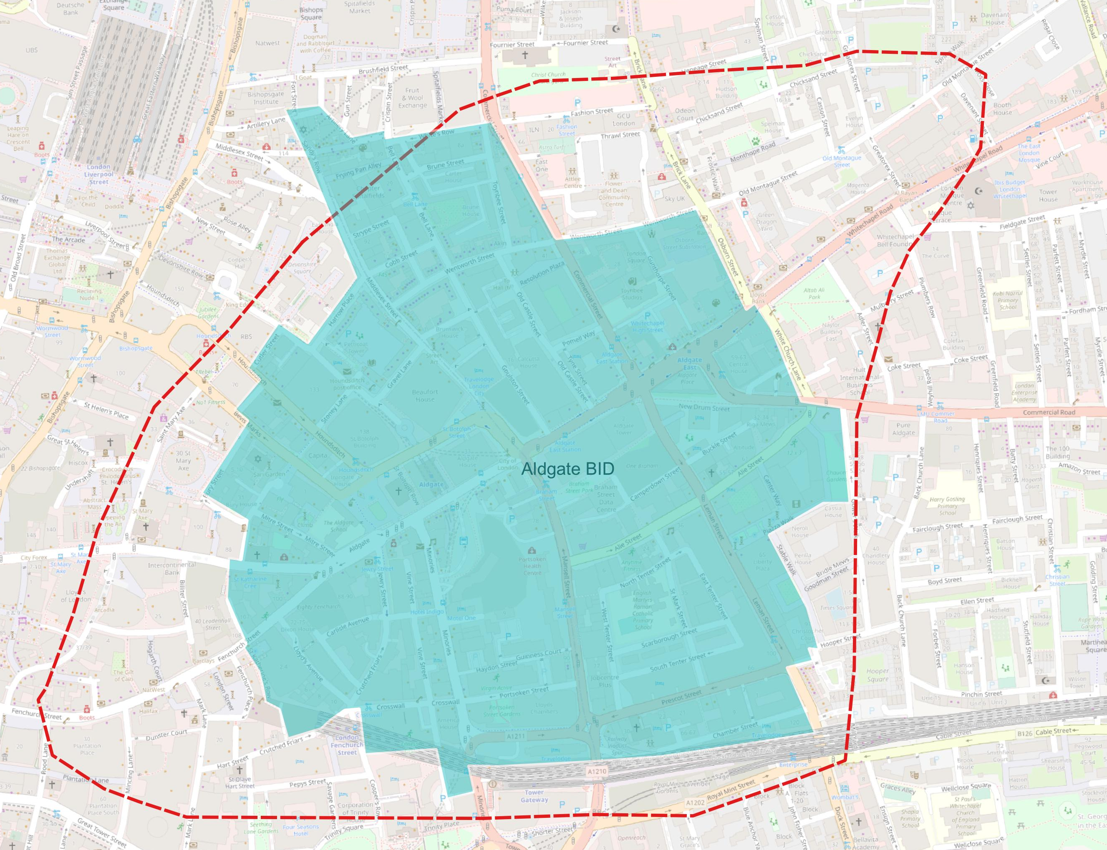
Appendix 1 Aldgate bid geography – Comparison with previous work
In preparing this Study, WSP has reviewed a report prepared by the economic consultancy firm Volterra in January 2017, which assessed the socio-economic profile of the then Aldgate Partnership. While the objectives of the Volterra report are similar to this one, the results are notably different. This can be explained by two factors.
Firstly, the geographic area used within the Volterra report is much bigger (approximately 85 hectares) compared to the detailed land area boundary WSP are using for the Aldgate Connect BID (50.6 hectares). The reduction in land area will have implications for all metrics calculated within this report including population, number of jobs, GVA generation and taxation. The differences in land areas assessed are set out in Table 8 and illustrated graphically in Figure 27.
Secondly, WSP have adopted a different approach to calculating job numbers across the BID than that undertaken by Volterra. Volterra’s methodology entailed taking the employment numbers from the 2011 Census at the work zone geographic level, and applying to this a growth rate based on the 2011 and 2015 employment numbers from BRES data for the LSOAs.
WSP’s approach has taken the more up-to-date LSOA employment data and scaled this based on the proportion of the BID within each LSOA using GIS applications. More details behind this approach can be found in Appendix 2.
The result of these two factors is that the socio-economic metrics identified in this report are generally lower than those identified within the Volterra report. However, they are a fair representation of the newly defined Aldgate Connect BID.
Figure 27 – Aldgate Partnership (red dotted line) vs Aldgate Connect (blue) BID boundaries
Background Map: OS
Table 8 – Comparing the Aldgate BID area – Aldgate Partnership vs Aldgate Connect
 | City of London (ha) | Tower Hamlets (ha) | Total (ha)
Aldgate Partnership | 37.4 | 47.6 | 85.0
Aldgate Connect | 22.5 | 28.1 | 50.6
Source: Volterra Report and WSP Calculations

Slide 39
Appendix 2 Aldgate bid proportions
As set out in the main body of the report, the geography of the Aldgate Connect BID area does not match exactly with any geographical areas for which data is recorded. For example, the BID has a presence across nine LSOAs to varying degrees (see Figure 28 for an example of this). As a result, estimates of economic statistics are approximated and scaled based on the proportion of the Aldgate Connect BID within geographical areas for which data is available, calculated using GIS.
Using GIS software, each LSOA has been analysed to determine the proportion of the area which covers the BID geography.
The following values have been quantified and have been rounded to nearest 5%:
City of London 001E – 75%;
City of London 001F – 5%;
Tower Hamlets 015B – 10%;
Tower Hamlets 015E – 85%;
Tower Hamlets 015A – 5%;
Tower Hamlets 015D – 15%;
Tower Hamlets 021D – 15%;
Tower Hamlets 021E – 35%; and
Tower Hamlets 021F – 80%.
WSP has determined this to be the most robust approach to calculating and scaling key economic metrics including: population, employment, job density and Gross Value Added for the BID area.
Advantages of using this method
LSOA data uses the most up-to-date information rather than historic census data.
There isn’t the requirement of applying growth factors to forecast recent years.
Limitations
The dispersion of different metrics including jobs and population are equal across the LSOA without allowing for any clustering in parts of the LSOA.
Figure 28 – Aldgate BID area boundaries (blue) relative to LSOA boundaries (orange)
Background Map: OS

