Slide 1
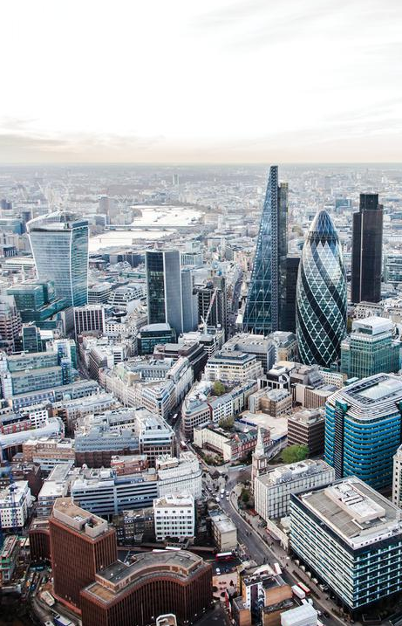
Business Improvement districts:
Baseline Study & Economic Analysis
December 2020
Source: Leadenhall Building

Slide 2
Contents
 | Chapter | Page Number
1. | Introduction | 3
2. | Socio-economic Baseline Assessment | 4
3. | Conclusions | 13

Slide 3
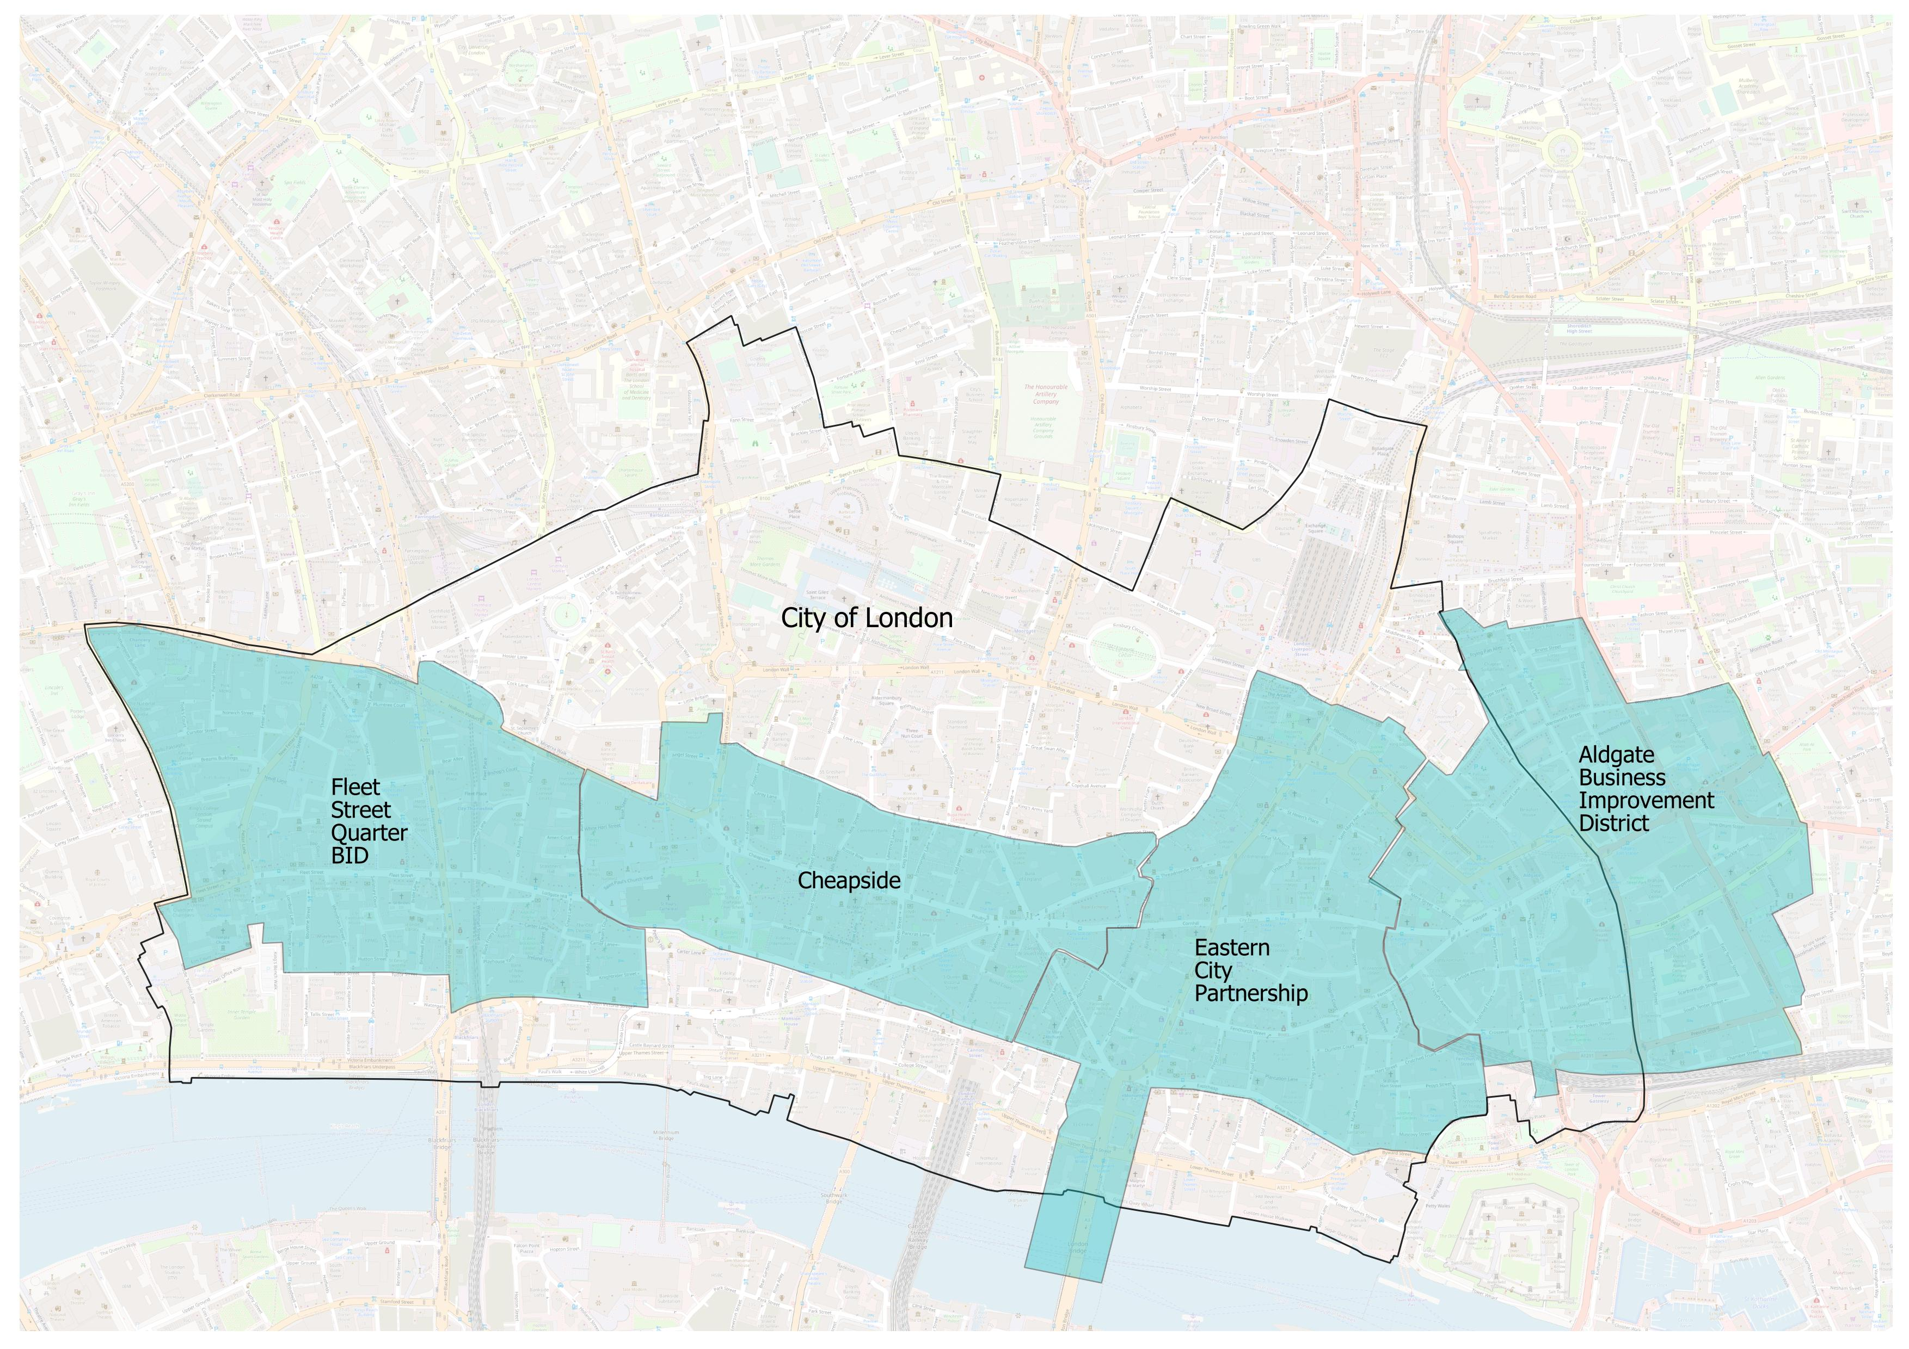
introduction economic Context and geography
WSP were commissioned by Primera Corporation to prepare detailed socio-economic baseline studies into four Business Improvement Districts (BIDs) and Partnerships located within the City of London. The four BIDs and Partnerships assessed were:
Fleet Street Quarter (FSQ);
Cheapside Business Alliance (Cheapside);
Eastern City Partnership (Eastern City); and
Aldgate Connect (Aldgate).
The individual reports quantified the key economic characteristics and profiles of the respective BID and Partnership areas, assessed the potential impact of each area’s development pipeline, as well as identified future opportunities and challenges which will impact the areas going forward.
The four separate reports can be viewed via WSP or Primera on request.
The purpose of this report is to collate the key headline findings for each of the BID and Partnership areas, in order to quantify the overall economic impact the four areas have to London as a whole. In doing so, the collective economic contribution of the four BID and Partnership areas can be assessed.
Please note, all data sources, methodological processes, analysis, and consultations undertaken can be referred to in detail in the individual study reports. This report represents a high level overview of the work undertaken.
Geography
The four BIDs and Partnerships are located either wholly within the City of London local authority, or within both the City of London and Tower Hamlets, as is the case for the Aldgate Connect BID. The boundaries of the respective Study Areas, in relation to the City of London boundary is illustrated in Figure 1.
In terms of smaller geographical areas, the BIDs and Partnerships have a presence across a range of Lower Super Output Areas (LSOAs) to varying degrees. LSOAs are an ONS geography and one of the smallest areas for which economic and social data can be analysed.
Appendix 1 provides an overview of each of the LSOAs which the respective Study Areas have a presence in.
For the purpose of this report, the four City BID and Partnership areas will collectively be referred to as the Study Areas.
Figure 1 – Each BID/Partnership observed in this report

Slide 4
2. Socio-economic baseline assessment

Slide 5
population bid populations
Figure 2 – Population and age profile of each BID/Partnership
8,050
Amongst the four Study Areas, Aldgate has the largest residential population at approximately 8,050 people (1,480 residing within the City of London portion of the BID and 6,570 within Tower Hamlets).
This is far greater than the residential populations of Cheapside (690), Eastern City (440) and the Fleet Street Quarter (870), and reflects the fact that the Aldgate BID straddles both the employment dense areas of the City of London, and more residential oriented areas in Tower Hamlets (Figure 2). Aldgate has also seen strong growth in its population in recent years. In comparison to 2015, the total population has increased from 6,300 to 8,050, a growth rate of 28%.
The three other Study Areas, given their location wholly within the City of London, unsurprisingly have fewer permanent residents. Indeed, the City of London as a whole has the smallest residential population of any local authority in London, with an estimated 9,721 people residing in the borough in 2019. With an estimated 6,506 dwellings in the City of London, this equates to 1.42 people per dwelling, significantly lower than the UK average of 2.4. The respective populations of Cheapside, Eastern City, the Fleet Street Quarter and the portion of Aldgate within the City, account for approximately 7%, 5%, 9% and 15% of the total City population. Together they account for 36% of the City of London’s population.
In terms of the age profile of the Study Areas, all four are made up of predominantly working age populations (age 16-64), accounting for on average 77% of the respective populations.
The significant differences in the populations of the four Study Areas is reflected in the population density data, with Aldgate’s population of 8,050 equating to a population density (number of people per square km) of 15,920. This is significantly greater than that recorded for Cheapside (2,320), the Eastern City (1,040), the Fleet Street Quarter (2,010), the City of London (3,350) and London more generally (5,700). This is illustrated in Figure 3.
This is what one would typically expect given that in general, dense residential locations such as Tower Hamlets have higher levels of population density since demand for residential space crowds out commercial space. The opposite is true for areas of higher employment density such as the City of London, and inner City BIDs such as Cheapside, the Eastern City Partnership and the Fleet Street Quarter.
However, as will be illustrated later in this report, Aldgate also has a relatively high concentration of employment. Aldgate is therefore a bit of an outlier in this respect, in that it has both high population and employment densities – again owing to the fact that it straddles both the City of London and Tower Hamlets local authorities.
690
440
870
Source: WSP Calculation based on ONS Population Estimates
Figure 3 - Population Density in 2019
Source: WSP Calculation based on ONS Population Estimates and land areas by the London Datastore

Slide 6
employment total jobs
Figure 4 - Total Employment supported across local authorities and growth in employment 2015-2018
15.8% increase in jobs 2015-2018
261,630 Jobs in 2018
The four Study Areas collectively support 261,630 jobs – 244,410 within the City of London and 17,220 within Tower Hamlets. Together, these account for approximately 48% of jobs within the City, and 6% within Tower Hamlets. The total jobs across the four Study Areas has grown by 15.8% between 2015-2018, greater than the overall increase in jobs seen across the City of London (15.3%), Tower Hamlets (7.7%), London (4.8%) and England as a whole (3.7). This is illustrated in Figure 4.
The Eastern City supports the most jobs, at 82,710, followed by the Fleet Street Quarter (76,310), Cheapside (55,510) and finally Aldgate (47,100). The number of jobs supported within Aldgate is notably less than the other Study Areas. This is a consequence of its greater land use mix, with a higher proportion of land within the BID allocated for residential uses and associated amenity services, to support its larger residential population (see previous slide). That said it remains a significant employment area within London.
All four Study Areas have seen growth in employment in recent years, with the Eastern City seeing the greatest increase in employment since 2015 (18.3% or 5.8% CAGR). This is followed by Cheapside (16.7% or a CAGR of 5.3%), the Fleet Street Quarter (15.9% or a CAGR of 5.0%) and finally Aldgate (10.3% or a CAGR of 3.3%). This is illustrated in Figure 5.
The CAGR for the three former Study Areas are greater than that for the City of London (4.9%), Tower Hamlets (2.5%), and London (1.6%) as a whole, illustrating that the areas have been performing well in recent years.
The collective employment supported across the Study Areas confirm them as major employment hubs and drivers of the London and wider UK economy.
Source: WSP Calculation based on Business Register and Employment Survey data
Figure 5 - Total employment supported across Study Areas and % change (growth) in employment
82,710
76,310
55,510
47,100
Source: WSP Calculation based on Business Register and Employment Survey data

Slide 7
Sector composition top employment sectors
Figure 6 - % of City of London Employment supported within the Study Areas
48% of the City of London jobs are located within the Study Area
As discussed on the previous slide, the four Study Areas account for approximately 48% of all jobs within the City of London (Figure 6).
Considering the sectoral mix, there are striking similarities between the top employment sectors across the areas. For the Eastern City Partnership, Cheapside, and Aldgate, the top two employment sectors are the financial and insurance sector, and the professional, scientific and technical sector.
For the Fleet Street Quarter, the order is reversed, predominantly to reflect the greater concentration of employment in the legal and accounting sectors within the area. The top employment sectors for each Study Area are set out below and in Figure 7.
Cheapside
Financial & Insurance – 23,200 jobs (41.8% of total)
Professional, Scientific & Technical – 10,500 jobs (18.9% of total)
Business Administration & Support Services – 6,290 jobs (11.3% of total)
Aldgate
Financial & Insurance – 12,560 jobs (26.7% of total)
Professional, Scientific & Technical – 10,720 jobs (22.8% of total)
Information and Communication – 5,360 jobs (11.4% of total)
Eastern City
Financial & Insurance – 35,250 jobs (42.6% of total)
Professional, Scientific & Technical – 15,230 jobs (18.4% of total)
Business Administration & Support Services – 9,850 jobs (11.9% of total)
Fleet Street Quarter
Professional, Scientific & Technical – 25,000 jobs (32.8% of total)
Financial & Insurance – 14,700 jobs (19.3% of total)
Business Administration & Support Services – 12,400 jobs (16.2% of total)
The broad sector analysis illustrates that the Study Areas specialise in highly-skilled industries which generate significant value to the local and wider economy.
At the same time, all four areas also support a relatively high proportion of jobs in the accommodation and food services sector. For each Study Area, this was the fifth biggest sector in employment terms and supports the hypothesis that the areas are service-based economies of two halves, comprising a set of globally competitive advanced producer services (e.g. financial/insurance, tech) together with more locally focused sectors (e.g. food and drink, accommodation) providing lower-value personal and household services. Both have grown in recent years and they are, to some extent, complementary.
Figure 7 - Largest employment sectors across the Study Areas (% of total)
Source: WSP Calculation based on Business Register and Employment Survey data

Slide 8
Sector composition top employment sectors
In order to ascertain a greater understanding of the services that drive each BID or Partnership, analysis has been undertaken using the more detailed 2 Digit Standard Industrial Classification (SIC) Codes. Based on this, the top 4 sub-sectors in terms of employment within each Study Area are shown in Figures 8.
There is again a striking similarity between the top employment sub-sectors across the Study Areas.
Activities auxiliary to financial services and insurance activities was the top sub-sector for three of the four Study Areas, with the Fleet Street Quarter the only one to buck the trend where Legal and accounting activities is the largest employment sector. The other dominant sector of employment across the Study Areas is Management Consultancy services and activities related to head offices.
The following are descriptions of the top sub-sectors shown across the four Study Areas.
Activities Auxiliary to Financial Services and Insurance Services This division includes the provision of services involved in or closely related to financial service activities, but not themselves providing financial services e.g. Stock Exchange and Foreign Currency Exchange.
Financial services activities, except insurance. This division includes (but not limited to) activities undertaken by: Banks, Building societies, Central banks, Savings banks and Credit unions.
Activities of head offices, management consultancy activities. This division includes (but not limited to): Activities of Head Offices, Public relation and communication activities, Business and other management consultancy activities and Financial Management.
Legal and Accounting services. This division includes activities undertaken by: law firms, accounting and auditing activities.
Figure 8 sets out the top employment sub-sectors across the four Study Areas, confirming the dominance of the financial service sector across the Eastern City and Cheapside BID in particular. This is underlined by the presence of the Bank of England within the Cheapside BID, as well as other major banks and insurance firms within the Eastern City such as Barclays, and the Lloyds of London Insurance market.
Meanwhile the data also confirms that the Fleet Street Quarter is the legal hub of the City, with the legal and accounting sector the dominant sub-sector of employment within the area. The area, as was assessed in more detail in the separate socio-economic report, is also home to a number of major accounting firms such as Deloitte and Ernst and Young.
The sectoral analysis supports views that were garnered across our discussions with members of the Fleet Street Board, in that in many respects the Fleet Street Quarter is not considered “part of the City” in the same way as the Cheapside BID and Eastern City Partnership are. This is reflected in its different sectoral make up, and the fact that its employment base is not driven to the same degree by the financial services sector.
Figure 8 - Largest employment sub-sectors across the Study Areas
Legal and accounting hub within Fleet Street Quarter
Core financial and insurance offering within Cheapside and Eastern City
Source: WSP Calculation based on Business Register and Employment Survey data

Slide 9
employment total jobs
In order to ascertain the relative employment contribution of each Study Area in relation to their geography, the number of jobs supported within each BID or Partnership has been compared against their corresponding total land area (within the City of London).
The Study Areas accounted for the following proportions of employment within the City of London (see Figure 9 for a visual representation):
Fleet Street – 15.1% of the City of London employees
Cheapside – 11.0% of the City of London employees
Eastern City – 16.3% of the City of London employees
Aldgate – 5.9% of the City of London employees
In relation to the total land area, the following are the respective proportions of each Study Area’s land area within the City of London:
Fleet Street – 14.9% of the City of London land area
Cheapside – 10.2% of the City of London land area
Eastern City – 14.6% of the City of London land area
Aldgate – 7.7% of the City of London land area
The comparison between the two parameters is illustrated in Figure 9. Cheapside, the Eastern City Partnership and the Fleet Street Quarter all have a higher share of the City of London employment base compared to their respective land areas within the City, illustrating a proportionally larger employment contribution compared to other areas within the City (this is illustrated by being below the diagonal dotted line). This again supports the view that these areas are major employment hubs, even in comparison to other areas within the City of London.
Conversely Aldgate has a lower proportion of employees relative to its land area, a result of its more diverse land use, with a higher proportion of land allocated for residential purposes. This results in a lower employment density, as will be demonstrated on the following slide.
The Aldgate Connect BID also has part of its land area within the Tower Hamlets Local Authority District. It accounted for 5.8% of Tower Hamlets’ employees in 2018 and 1.4% of the land area, illustrating that the job density in the Tower Hamlet portion of the BID is significantly higher relative to the local authorities’ job density as a whole.
Figure 9 - Comparing employment and land area allocation across each of the Study Areas
Source: WSP Calculation based on Business Register and Employment Survey data

Slide 10
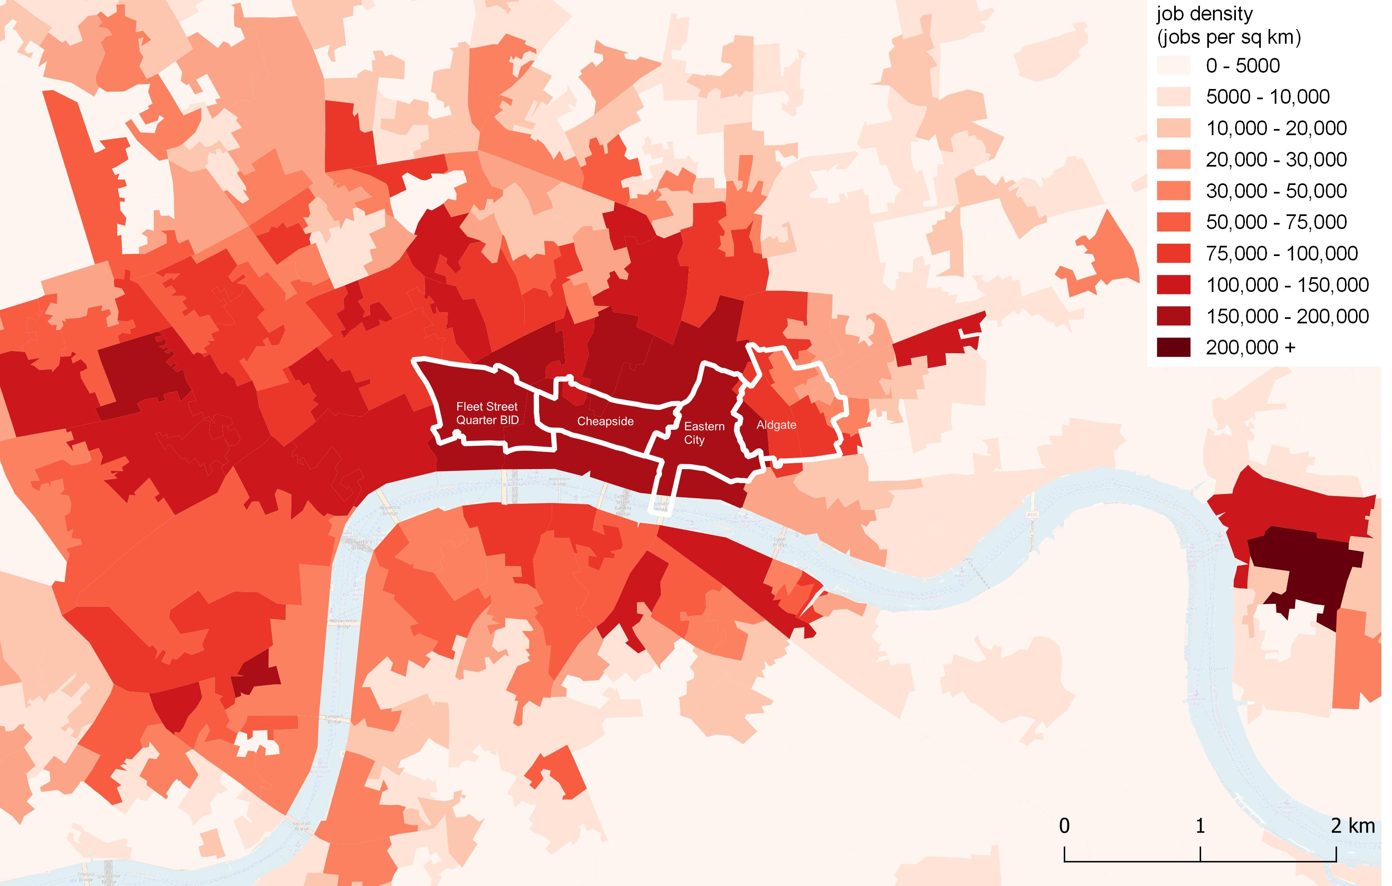
employment job density
Table 1 – Job Densities in 2018
Geography | Job Density (jobs per km²)
Fleet Street Quarter | 176,160
Cheapside | 187,000
Eastern City | 195,590
Aldgate | 93,130
City of London | 174,220
Tower Hamlet | 15,030
London | 3,280
Previous analysis has been undertaken to show approximately how many people were employed across each of the Study Areas in 2018. Applying the job estimates to the respective land areas in square km for each of the Study Areas provides an estimate of their employment density (jobs per square km). Table 1 illustrates the job density of each of the four Study Areas alongside other selected geographies.
As previously eluded to, Aldgate has a higher concentration of residential uses than the other Study Areas resulting in a lower job density (93,130).
Elsewhere Cheapside (187,000), the Eastern City (195,590) and the Fleet Street Quarter (176,160) all have job densities which are greater than the corresponding employment densities of the City of London (174,220) and Greater London as a whole (3,280).
Mapping the employment densities of each LSOA (Figure 10), with the Study Area boundaries superimposed over, illustrates this point. For instance, considering the Aldgate Connect BID, it is evident that employment density tapers off from areas of the BID located within the City of London, to the more residential focussed areas within Tower Hamlets. This effect is also evident when considering areas outside of the City of London where the inclusion of all non-employment land areas (e.g. housing, parks, open spaces), of which there is a greater prevalence outside of the City of London, results in the employment densities falling considerably. This is illustrated by the paler shades of red outside of the City of London.
The other three Study Areas are all amongst the densest employment areas within London, illustrated by the darker shades of red on the map. This confirms these areas as major employment hubs, even in comparison to the City of London as a whole.
Figure 10 - Job Density in Inner London (jobs per km², 2018)
Source: Business Register Employment Survey data

Slide 11
Output gross value added
Figure 11 – GVA (£ billions) generated across the four Study Areas
£35.2 billion GVA
48% of the City of London GVA is generated in the Study Areas
Gross Value Added (GVA) is a measure of goods and services produced within any given geographical area, and is the primary metric of the economic value generated by an area.
GVA data is unavailable at a more detailed geography than borough level. Each Study Area’s output has therefore been estimated by combining the GVA per worker by sector for the City of London or Tower Hamlets, with the employment by sector for each Study Area.
Based on this approach, the estimated total GVA of the four Study Areas together is approximately £35.2 billion. Proportioning the GVA by area, this equates to approximately 48% of the GVA generated in the City of London and 5% of the GVA generated in Tower Hamlets.
Figure 11 sets out the GVA generated across each Study Area. The Eastern City generates the greatest amount of GVA, at £11.8 billion, followed by the Fleet Street Quarter (£9.5 billion), Cheapside (£7.9 billion), and finally Aldgate (£6.0 billion). To put this into further perspective, a GVA of £35.2 billion equates to 8% of London’s total GVA and 2% of England’s GVA. This is a significant contribution coming from land areas which make up only 0.1% of London’s land size and 0.001% of England’s.
Figure 12 shows that the high value nature of the employment supported across the four Study Areas is reflected in the average GVA per worker. All four Study Areas have a GVA per worker considerably greater than the London average (£87,259), with both Cheapside (£142,490) and the Eastern City (£143,140) also above the City of London average (£136,595).
The GVA analysis illustrates the significant economic contribution that the four Study Areas make not only to London, but the wider national economy.
Figure 12 - GVA per worker (£) in 2018 (selected geographies)
Source: WSP Calculation based on GVA and Number of Employees (previous calculations)

Slide 12
Output gross value added
Figure 13 – Comparing GVA and Land Areas of each BID against the City of London
The GVA generated across each Study Area has been compared against the total land area of each (within the City of London).
Based on the preceding analysis, the Study Areas account for the following proportions of GVA generated in the City of London:
Fleet Street – 13.7% of the City of London GVA
Cheapside – 11.4% of the City of London GVA
Eastern City – 17.1% of the City of London GVA
Aldgate – 6.0% of the City of London GVA
In relation to the total land area, the Study Areas account for the following proportions within the City of London:
Fleet Street – 14.9% of the CoL land area
Cheapside – 10.2% of the CoL land area
Eastern City – 14.6% of the CoL land area
Aldgate – 7.7% of the CoL land area
The comparison between the two parameters is illustrated in Figure 13.
Cheapside and the Eastern City both have a higher proportion of the City of London’s GVA relative to their land area, represented by being just beneath the dotted line. The aligns with the GVA per worker data analysed previously, with these two areas generating a greater GVA per worker than the City of London average.
Conversely the Fleet Street Quarter and Aldgate both have a marginally lower proportion of the City of London GVA relative to their land areas.
The Aldgate Connect BID also has parts of its geography located in Tower Hamlets. It accounts for approximately 5.2% of the GVA of Tower Hamlets but only 1.4% of the total land area, illustrating a higher GVA per worker in the Tower Hamlets portion of the Aldgate BID, compared to Tower Hamlets as a whole.
Tax Revenue
Further analysis has been undertaken into the amount of GVA which accrues to the Treasury in the form of taxation.
The proportion of national income (i.e. total GVA) that accrues to the Treasury in the UK was estimated to be approximately 37% by the Institute for Fiscal Studies (IFS). Other publications has placed the figure between 30% - 40%. The main types of taxation are: Income Tax, National Insurance contributions and VAT which account for approximately two thirds of total taxation collected by the UK Government.
Using the IFS figure of 37%, it can be estimated that the four Study Areas collectively generated £13 billion in tax revenue in 2018, approximately half of the total tax revenue generated by the City based on this approach. The respective amounts by Study Area are broken down in Figure 14.
Figure 14 - Tax revenue (£ billions) by Study Area in 2018
£13 billion in tax revenue in 2018 which equates to approximately 51% of City of London total
Source: WSP Calculation based on GVA and Number of Employees (previous calculations)

Slide 13
3. Conclusions

Slide 14
Conclusion Findings of report
This report has provided a high level overview of some of key economic metrics WSP has analysed as part of their detailed socio-economic studies into the four BIDs and Partnerships.
The report has collated these statistics in order to ascertain the collective contribution the Study Areas make to the London economy and wider national economy.
The following sets out some of the key findings:
The total residential population across the four Study Areas was 10,050, with 80% of this population located within the Aldgate BID.
The four Study Areas collectively account for 36% of the City of London’s population.
The four Study Areas collectively support 261,630 jobs – 244,410 within the City of London and 17,220 within Tower Hamlets.
Together, the Study Areas account for approximately 48% of jobs within the City, and 6% within Tower Hamlets.
The total jobs across the four Study Areas has grown by 15.8% between 2015-2018, greater than the overall increase in jobs seen across the City of London (15.3%), Tower Hamlets (7.7%), London (4.8%) and England as a whole (3.7%).
The top sectors of employment across the four Study Areas are similar, with Financial and Insurance activities the dominant sectors of employment across Cheapside, Eastern City and Aldgate.
Within the Fleet Street Quarter, the dominant sector of employment is the Legal and Accounting sector, confirming the area as London's legal hub.
The estimated total GVA of the four Study Areas together is approximately £35.2 billion.
This equates to 48% of the GVA generated in the City of London and 5% of the GVA generated in Tower Hamlets.
GVA of £35.2 billion equates to 8% of London’s total GVA and 2% of England’s GVA.
GVA per worker for each of the Study Areas was considerably greater than the figure recorded for London as a whole, underlining the high value nature of employment supported across the areas.
The four Study Areas collectively generated £13 billion in tax revenue in 2018, making a significant contribution to the Exchequer.
Source: Getty Images – Fleet Street

Slide 15
Conclusion Findings of report
Table 2 – Key Findings from each Individual Report
For each of the Study Areas, the assessment has quantified the following:
Population (individually, collectively and as a % of the City of London as a whole);
Number of jobs supported (individually, collectively and as a % of the City of London as a whole);
Recent job growth (individually, collectively and in relation to the City of London as a whole);
Gross Value Added (individually, collectively and as a % of the City of London as a whole);
GVA per worker (individually, collectively and in relation to the City of London as a whole); and
Tax Revenue (individually, collectively and as a % of the City of London as a whole).
Table 2 summarises the findings from this report.
 | Cheapside | Aldgate | Eastern City | Fleet Street | Collective Total |  | % of City of London / Comparison with City of London
Population | 690 | 8,050 | 440 | 870 | 10,050 |  | 36% of the City of London Population
Number of Jobs | 55,510 | 47,100 | 82,710 | 76,310 | 261,630 |  | 48% of the City of London Population
Job growth (2015-2018) | 16.7% | 10.3% | 18.3% | 15.9% | 15.8% |  | 15.3% growth across the City of London
Gross Value Added | £7.9 billion | £6.0 billion | £11.8 billion | £9.5 billion | £35.2 billion |  | 48% of the City of London GVA
GVA per worker | £142,490 | £126,490 | £143,140 | £123,960 | £134,020 (average) |  | £136,595 (City of London GVA per worker)
Taxation Revenue | £2.9 billion | £2.2 billion | £4.4 billion | £3.5 billion | £13 billion |  | 51% of the City of London

Slide 16
appendix

Slide 17
Appendix 1 gis analysis
Table 3 – LSOAs in each BID area
As set out in the main body of the report, the geography of the respective Study Areas do not match exactly with any geographical areas for which data is recorded. For example, the Study Areas have a presence across a number of different LSOAs to varying degrees.
As a result, estimates of economic statistics are approximated and scaled based on the proportion of the respective BIDs and Partnerships within geographical areas for which data is available, calculated using GIS.
Table 3 sets out the LSOAs which each Study Area has a presence in. More detail on the exact proportions of each Study Area within each LSOA can be found in the individual Study reports.
WSP has determined this to be the most robust approach to calculating and scaling key economic metrics including: population, employment, job density and Gross Value Added for each Study Area.
Advantages of using this method
LSOA data uses the most up-to-date information rather than historic census data.
There isn’t the requirement of applying growth factors to forecast recent years.
Limitations
The dispersion of different metrics including jobs and population are equal across the LSOA without allowing for any clustering in parts of the LSOA.
Local Authority | LSOA | Cheapside | Aldgate | Eastern City | Fleet Street Quarter
City of London | 001A | ✓ | X | X | X
City of London | 001B | ✓ | X | X | X
City of London | 001C | X | X | X | X
City of London | 001E | X | ✓ | ✓ | X
City of London | 001F | ✓ | ✓ | ✓ | ✓
City of London | 001G | X | X | X | ✓
Tower Hamlets | 015E | X | ✓ | X | X
Tower Hamlets | 021F | X | ✓ | X | X
Tower Hamlets | 015A | X | ✓ | X | X
Tower Hamlets | 015B | X | ✓ | X | X
Tower Hamlets | 015D | X | ✓ | X | X
Tower Hamlets | 021D | X | ✓ | X | X
Tower Hamlets | 021E | X | ✓ | X | X

